Slide 1

FIND AND BOOK SALON
GROUP NO: 1
Internal Guide:
Miss. Nithya Nadar
External Guide:
Mr. Ronald Macwan
18BCA100 Hunny Shah
18BCA126 Vidhi Shah
18BCA151 Hansika Asthana

Slide 2
1. Company Profile
2. Project Definition
3. Tools And Technology Used
CONTENTS
4. Screen Layouts
USER
SALON OWNER
ADMIN
5. Bibliography
6. Conclusion

Slide 3

COMPANY PROFILE
About Company:
Unicorn Technolabs is a Website and Mobile App Development Company, located in Ahmedabad.
The company is known for Internet Website Developers, Computer Software Developers, Internet Website Designers, Mobile Application Developers and much more.
This establishment acts as a one-stop destination servicing customers both local and international.
Organization/Company Details:
Company Name : Unicorn Technolabs
Contact No. : (+91) 7818075214
Address : K16- Krishna Center,
Mithakhali Six Road,
Navrangpura, Ahmedabad
E-mail Address : info@unicorntechnolabs.com
Website : http://unicorntechnolabs.com

Slide 4
PROJECT DEFINITION
The Find and Book Salon is a web-based Salon management Application with appointment and scheduling functionality.
The aim is to develop an online software which connects users and multiple salon owners in an online community allowing users to browse salons and their services.
Subscribing to this software, the salon owners can manage online bookings which provides a new way to their business. Also, this software increases efficiency and service quality for the users by giving ratings to Salons.
The website has mainly four types of user groups: Salon owner, Users, Visitors and Website administrator.

Slide 5






TOOLS AND TECHNOLOGY USED
Front End:
IDE:
PHP 7.3
Apache NetBeans IDE 12.0
Back End:
Others:
MySQL 5.0
PHP Report Maker
Server:
Apache
MS Office 2019

Slide 6
USER SIDE
SALON OWNER SIDE
SCREEN LAYOUTS
ADMIN SIDE
USER
REPORTS

Slide 7
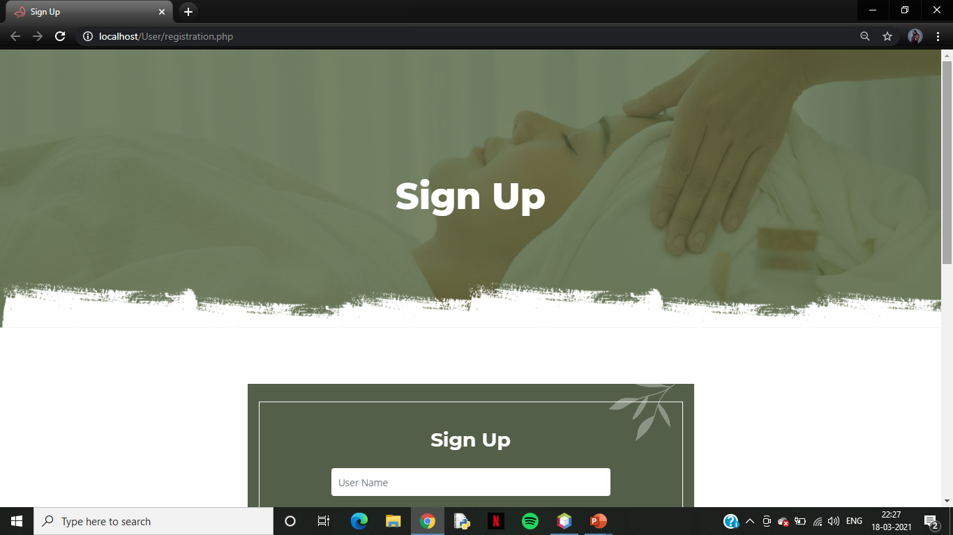
User: Sign Up Page

Slide 8
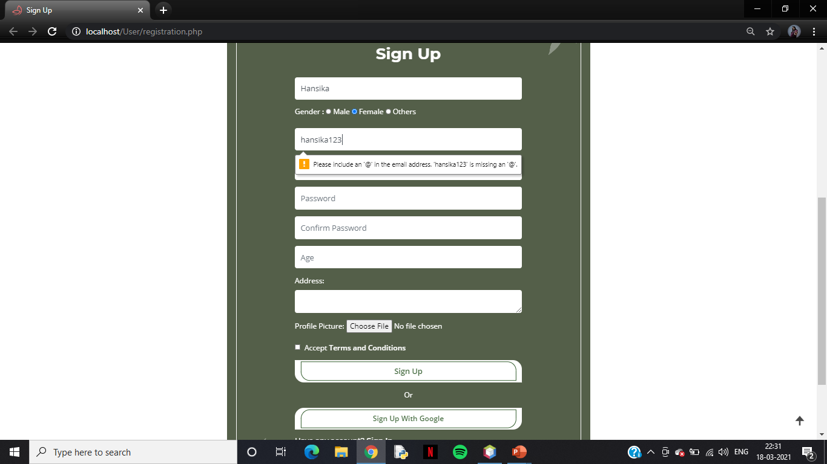
Sign Up Page which shows Validations

Slide 9
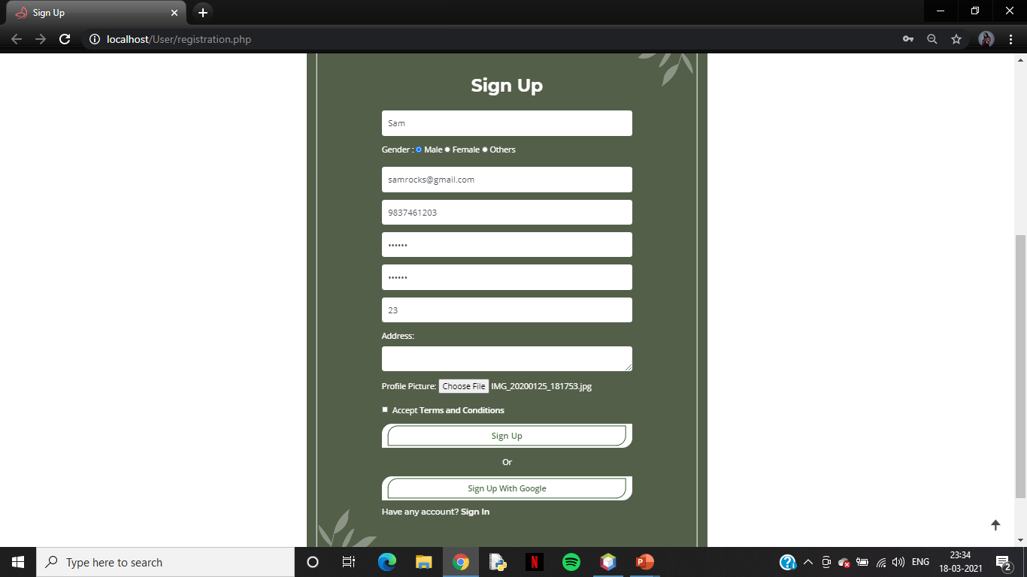
Sign Up Page continue…

Slide 10
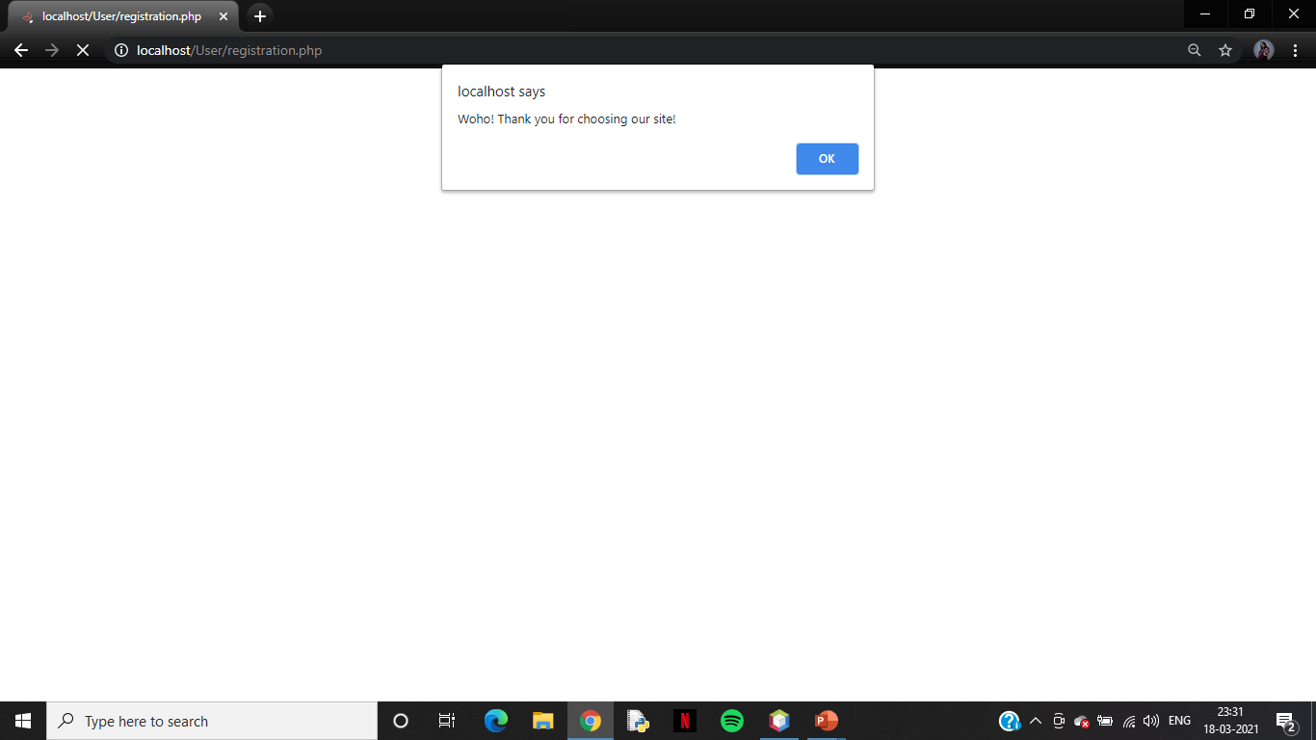
Signed Up Successfully!!

Slide 11
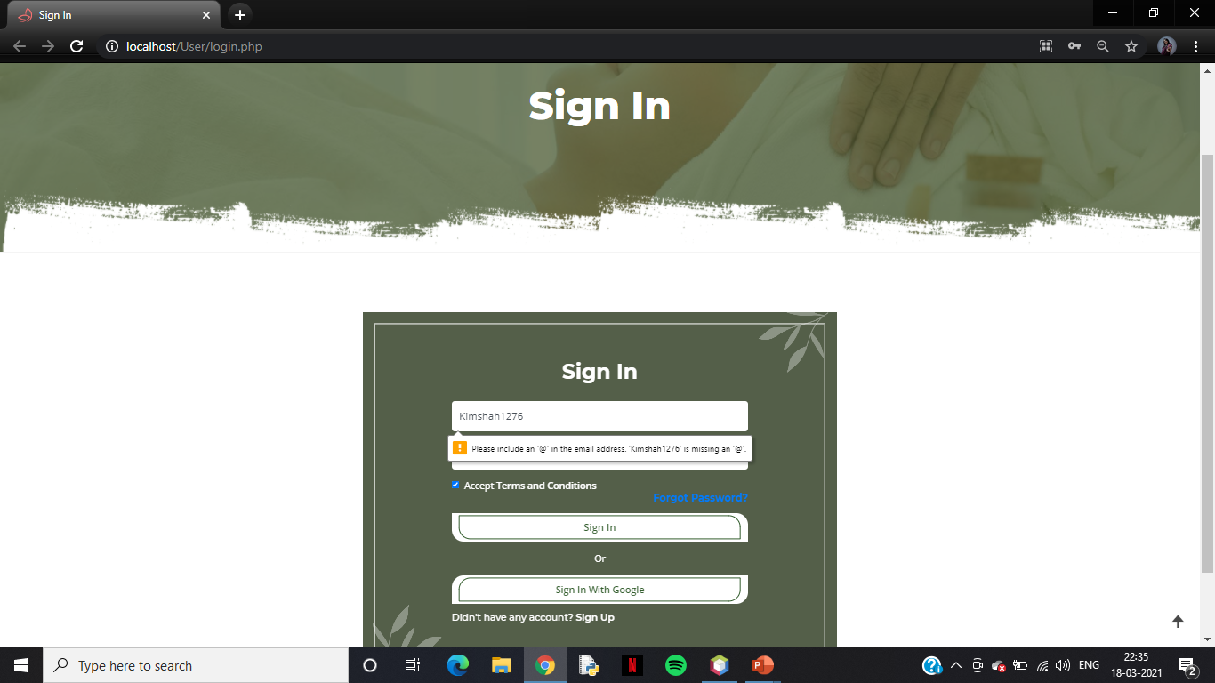
Sign In Page which shows Validations

Slide 12
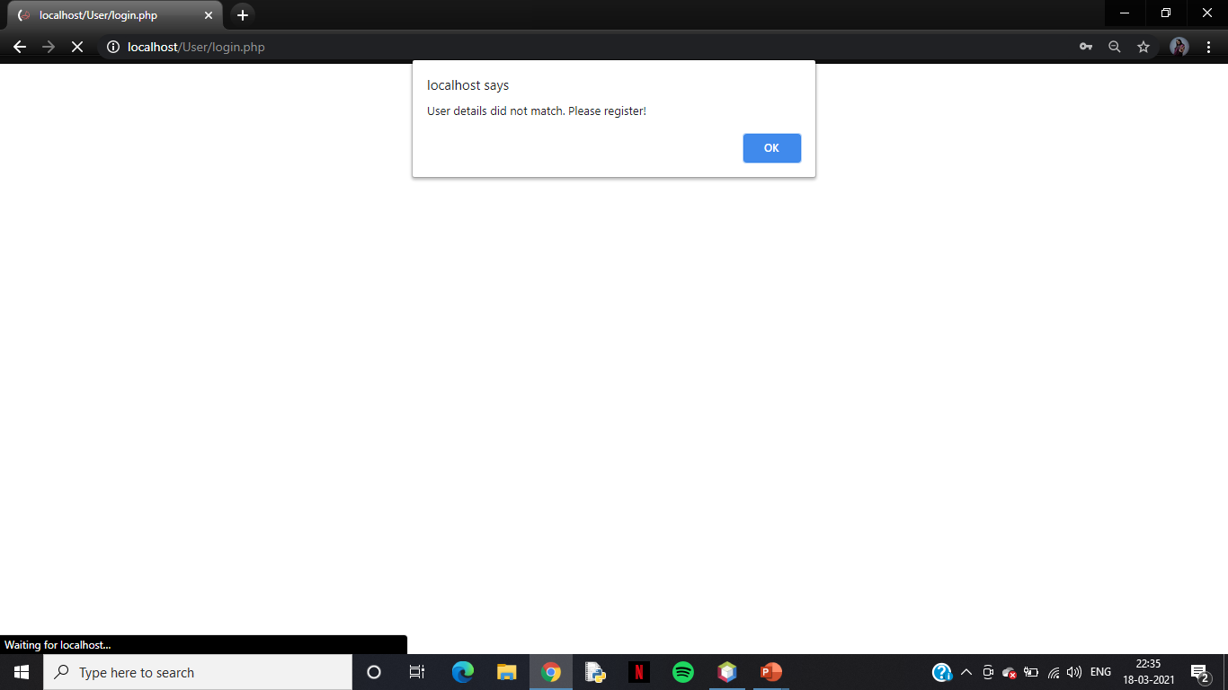
Sign In details does not match

Slide 13
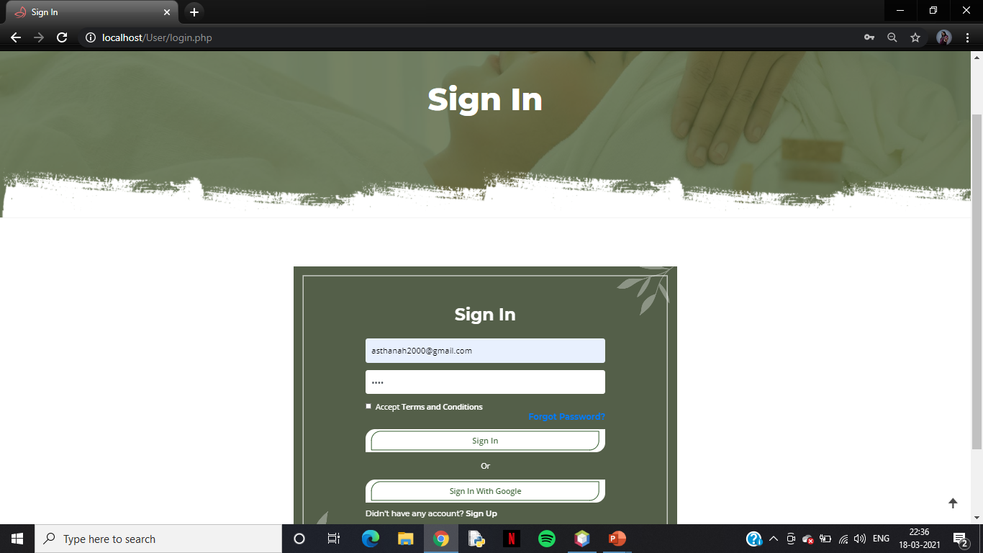
User: Sign In Page with Valid Data

Slide 14
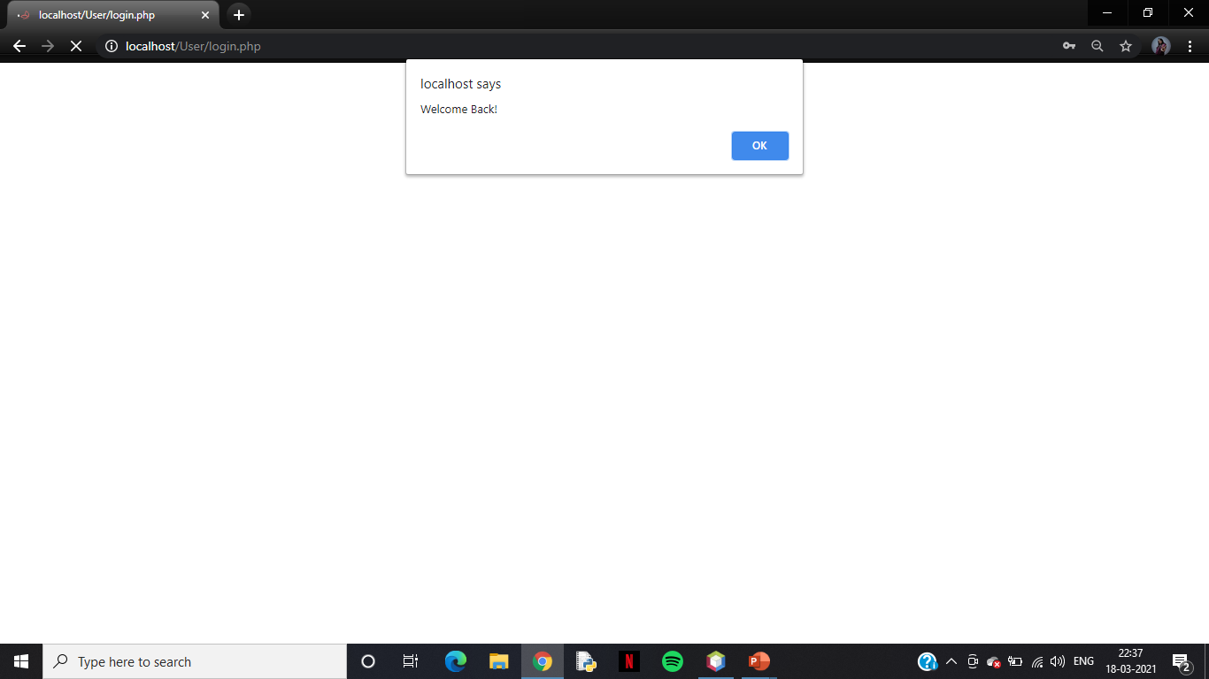
User Signed In Successfully!!

Slide 15
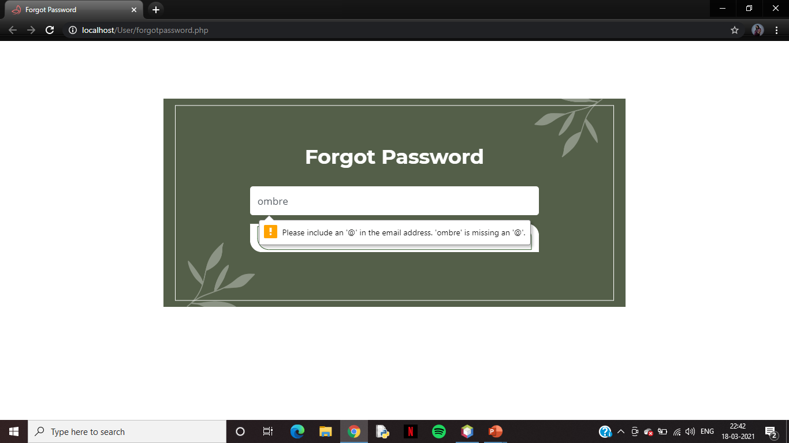
Forgot Password which shows Validations

Slide 16
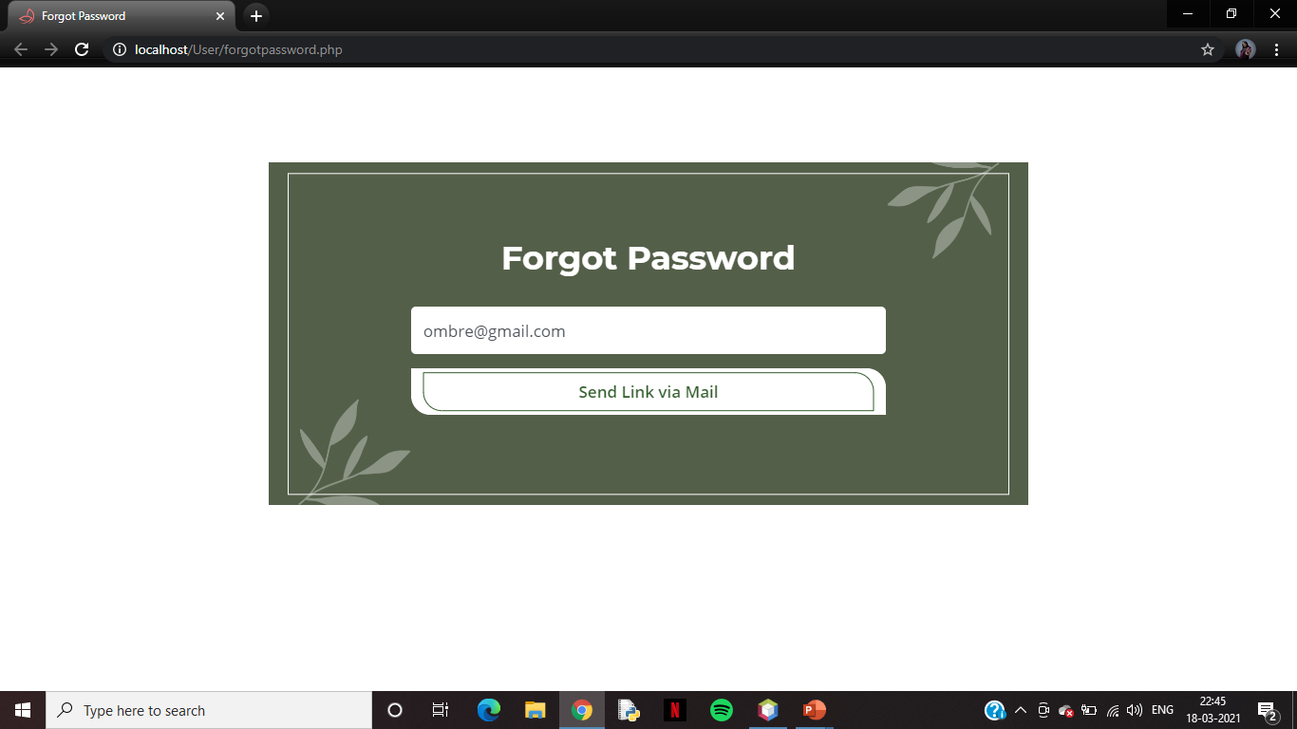
Forgot Password with Valid Data

Slide 17
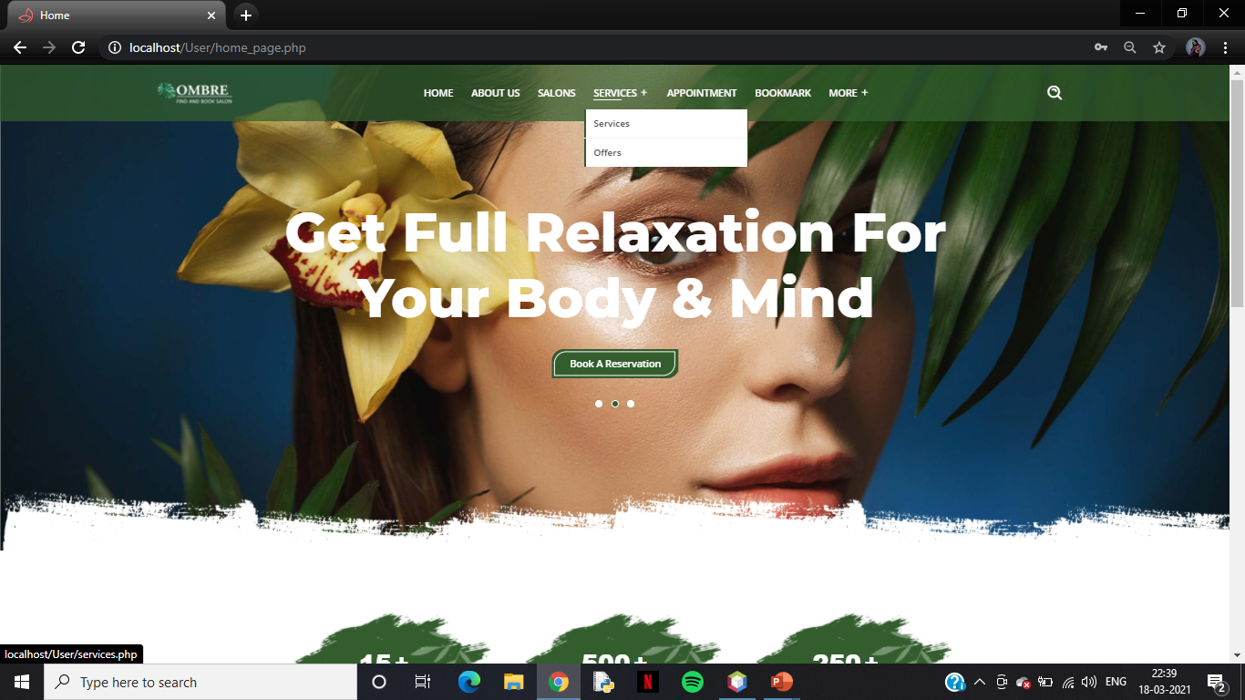
User Homepage

Slide 18
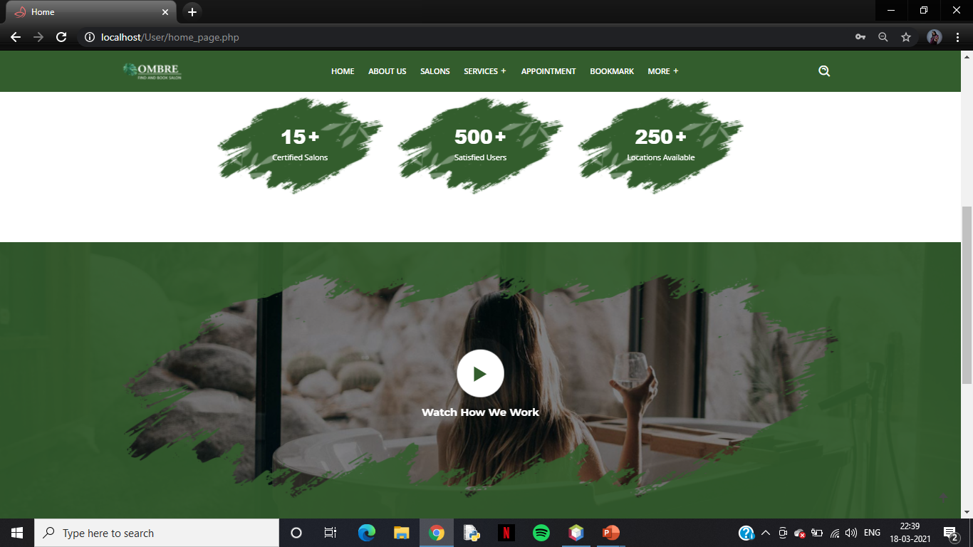
User Homepage continue..

Slide 19
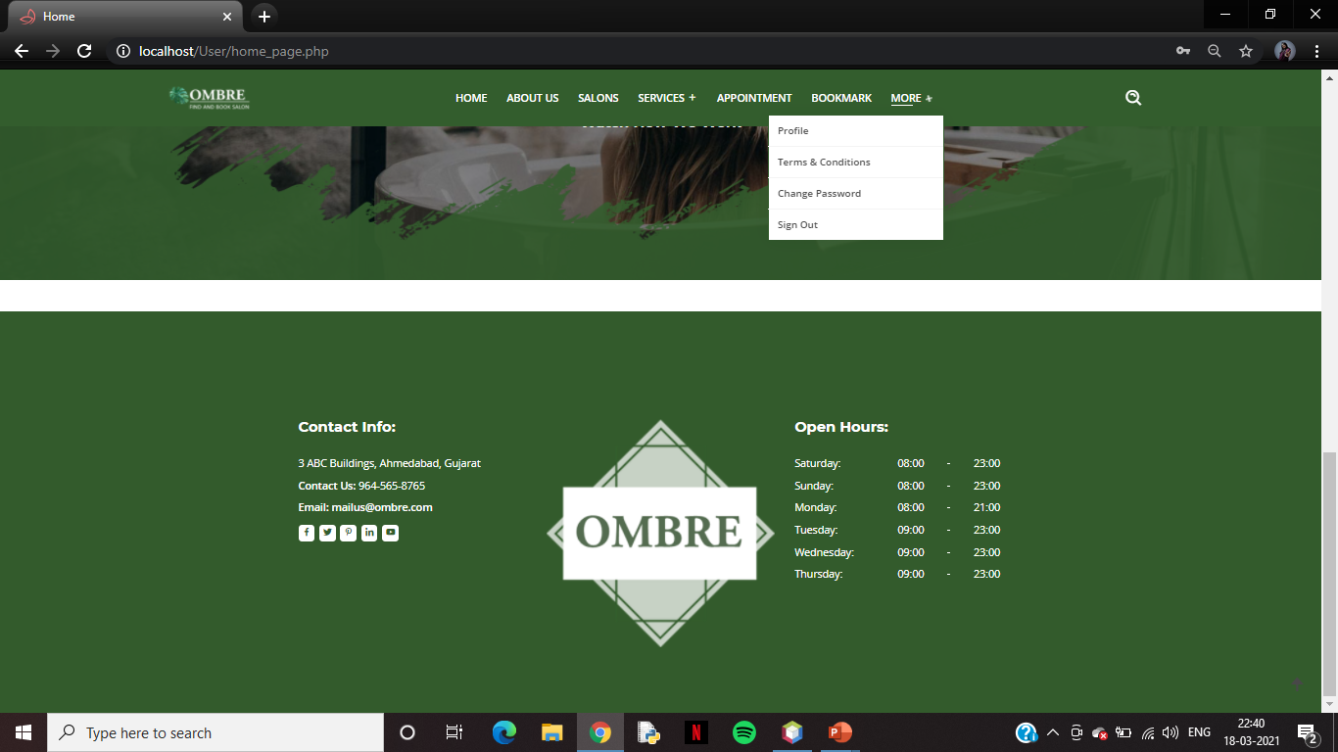
User Homepage continue..

Slide 20
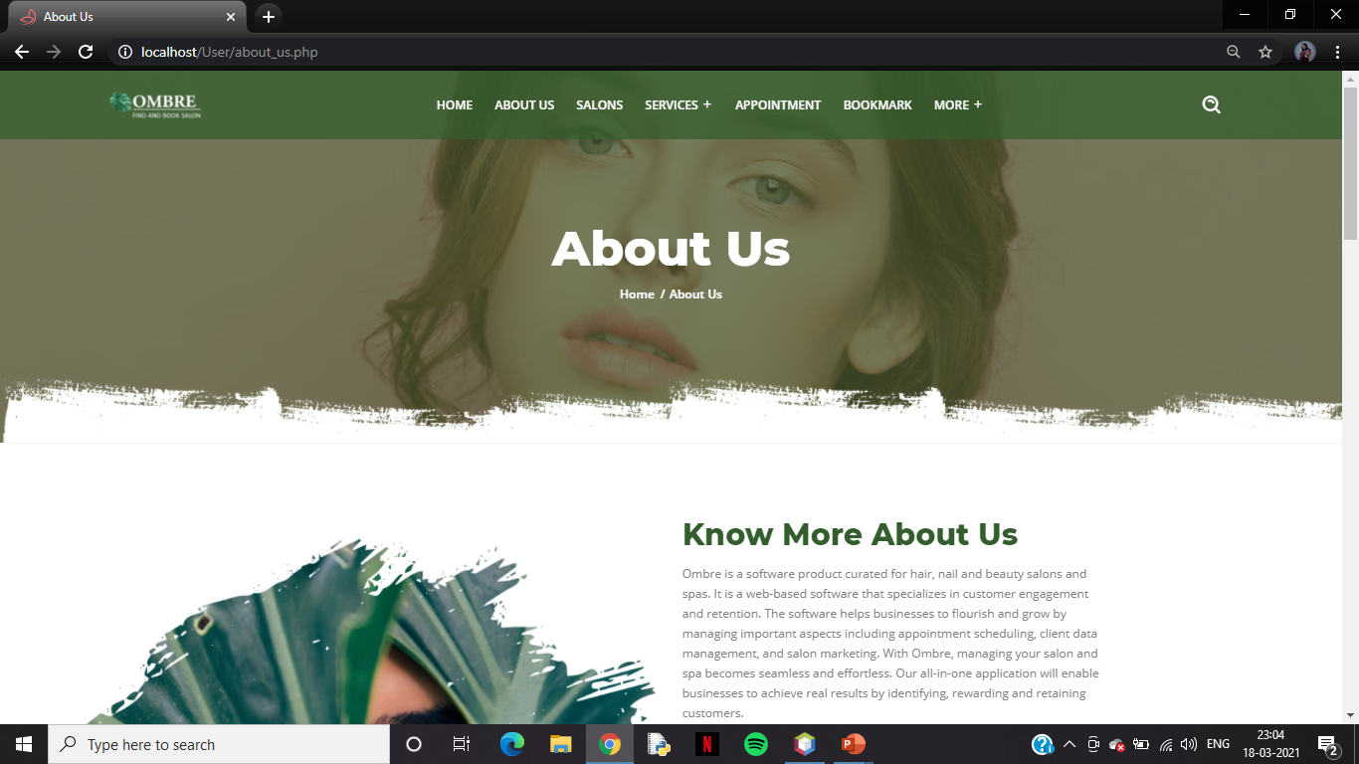
About Us Page

Slide 21
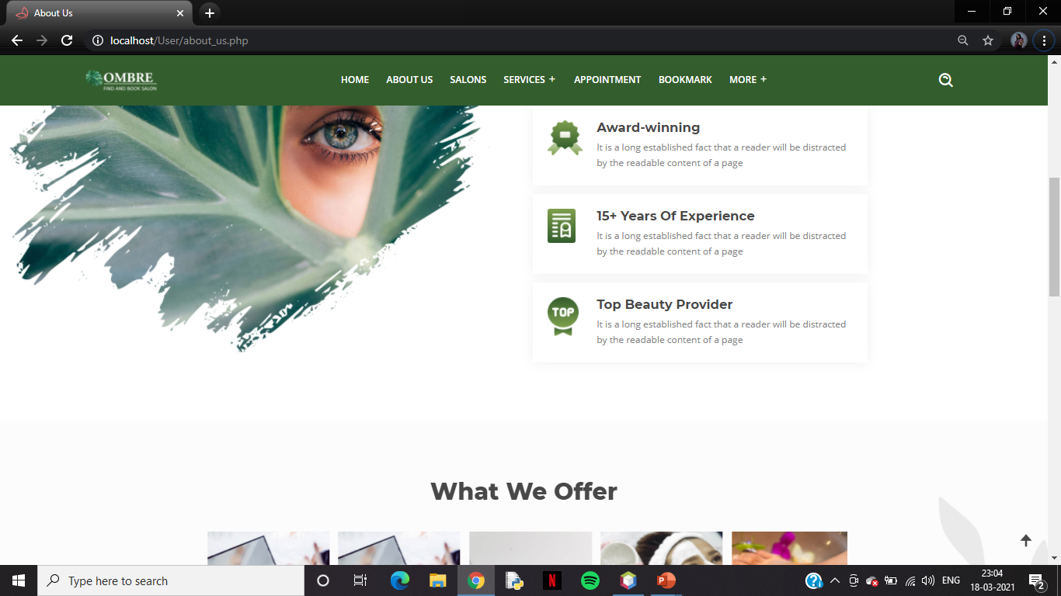
About Us Page continue..

Slide 22
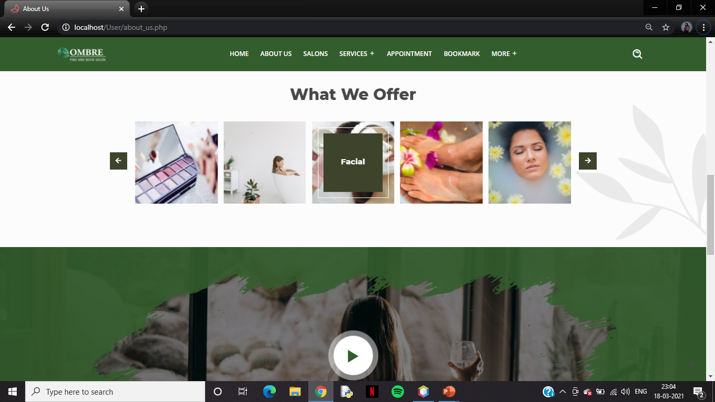
About Us Page continue..

Slide 23
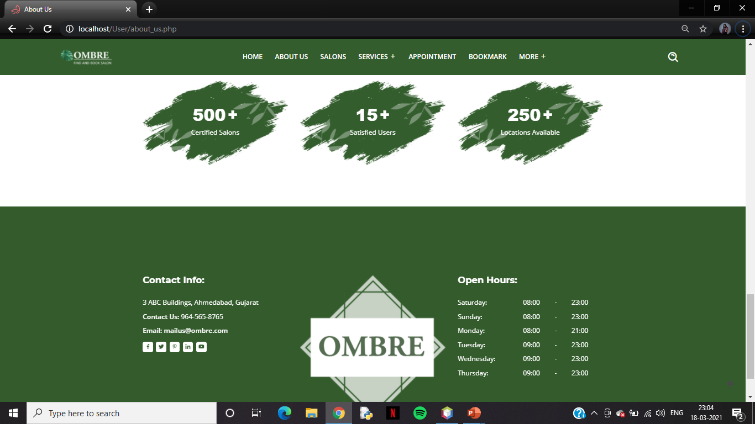
About Us Page continue..

Slide 24
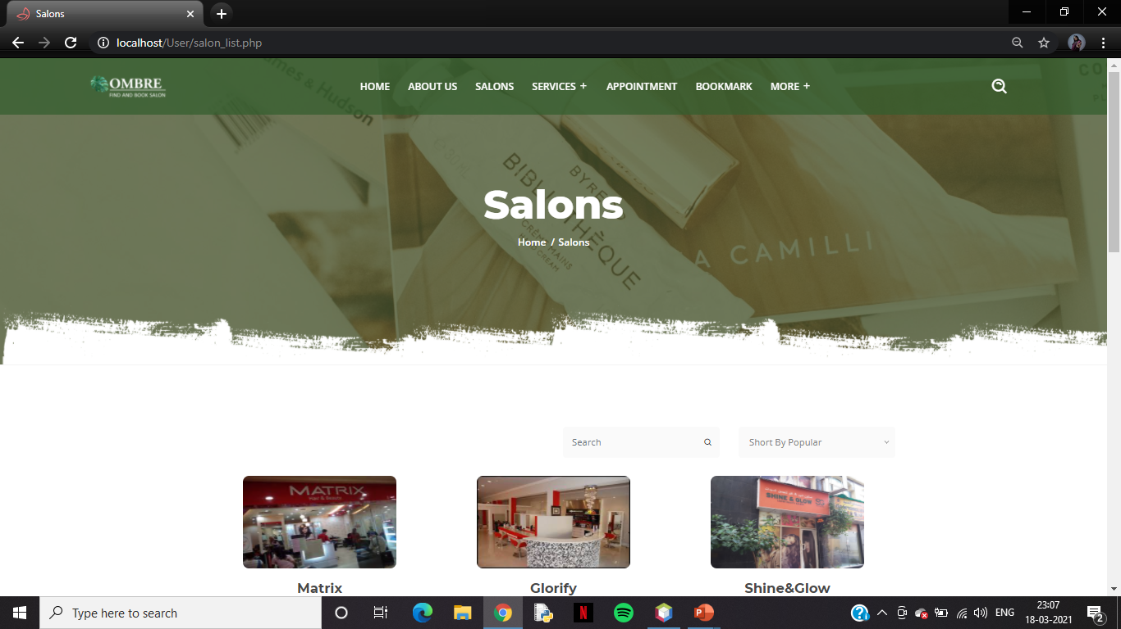
List of Salons

Slide 25
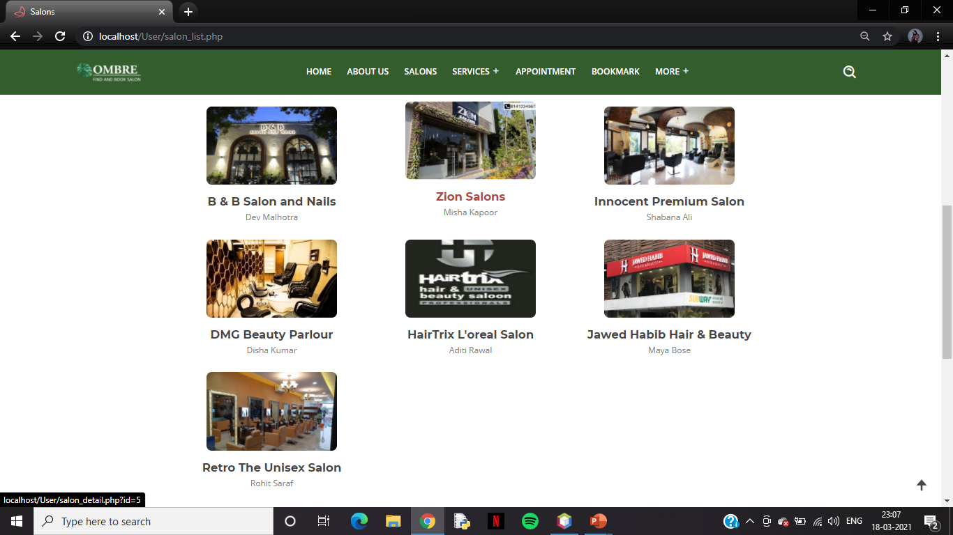
List of Salons continue..

Slide 26
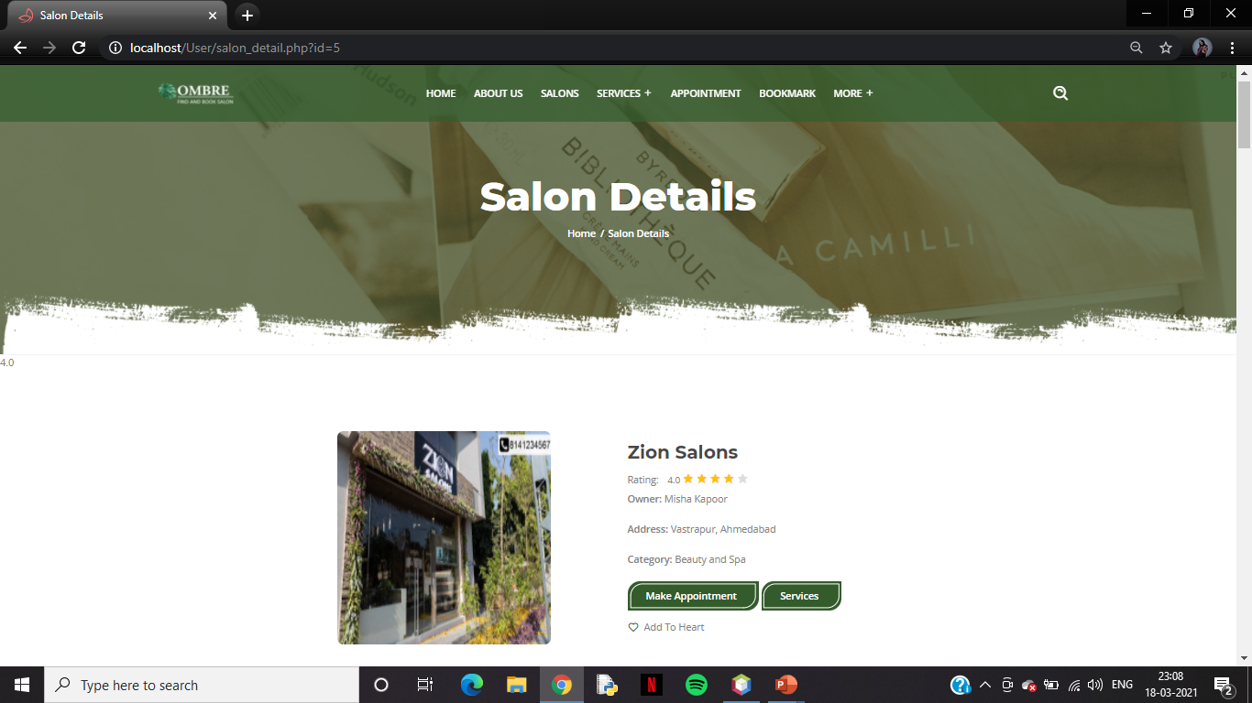
Salon Details

Slide 27
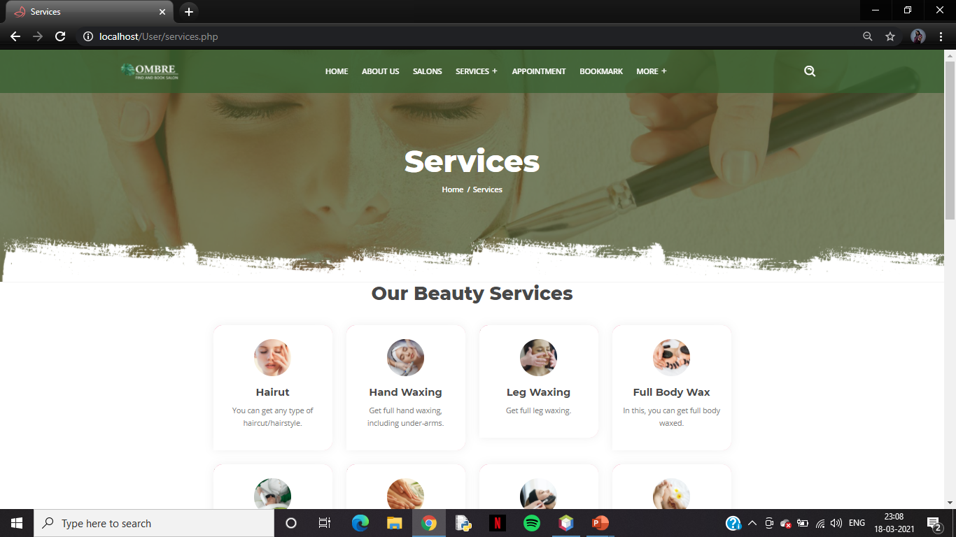
Services Page

Slide 28
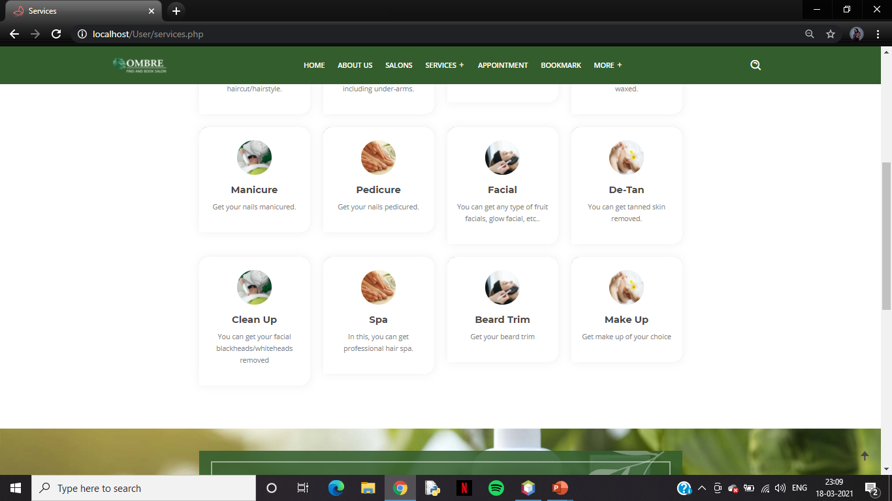
Services Page continue..

Slide 29
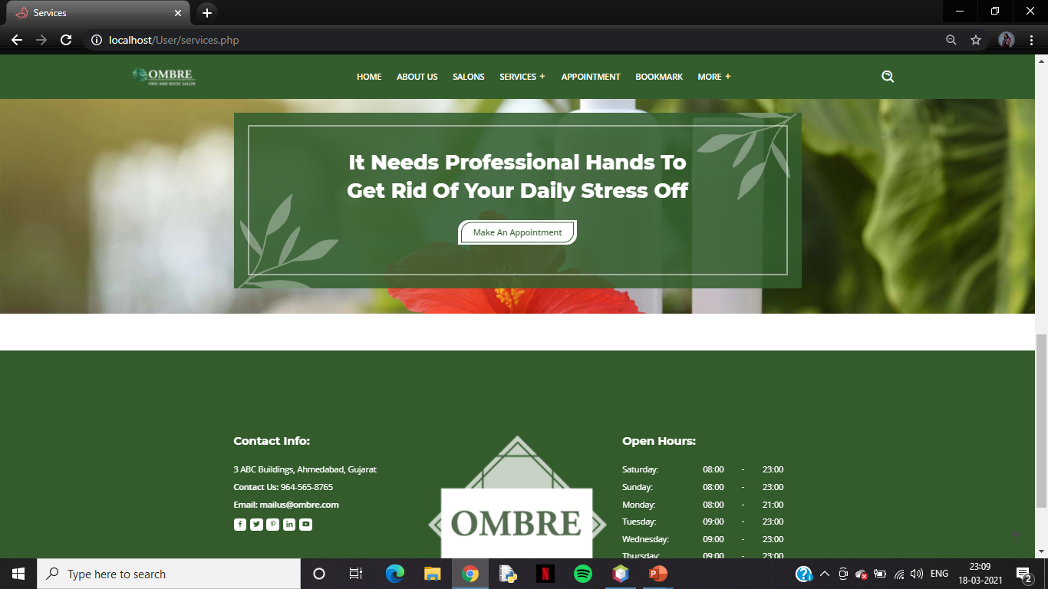
Services Page continue..

Slide 30
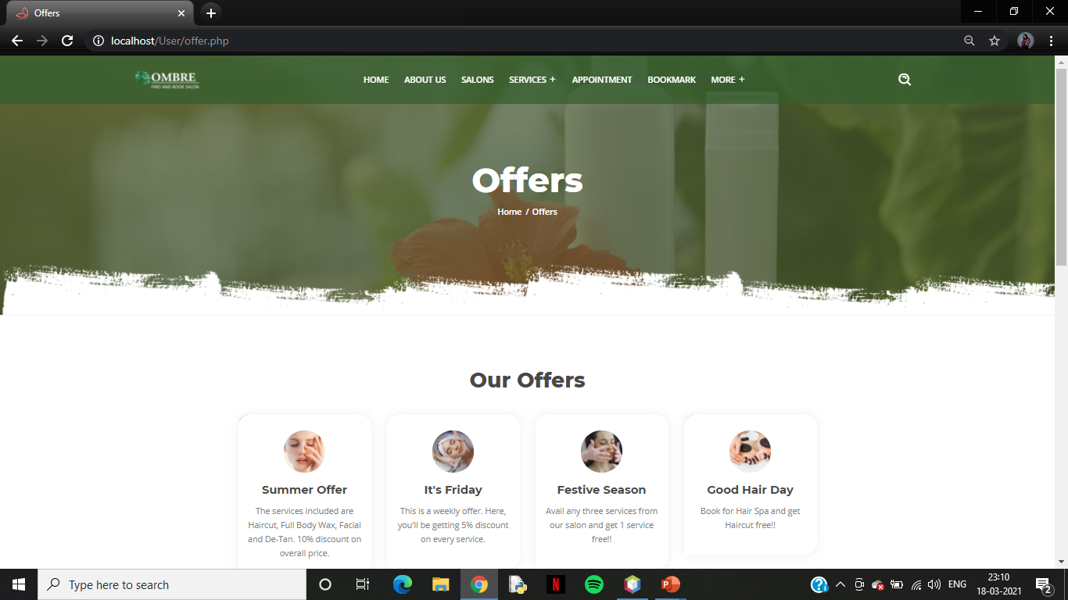
Offers Page

Slide 31
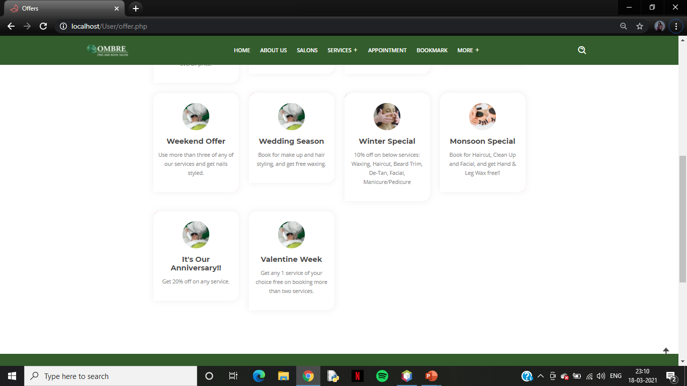
Offers Page continue..

Slide 32
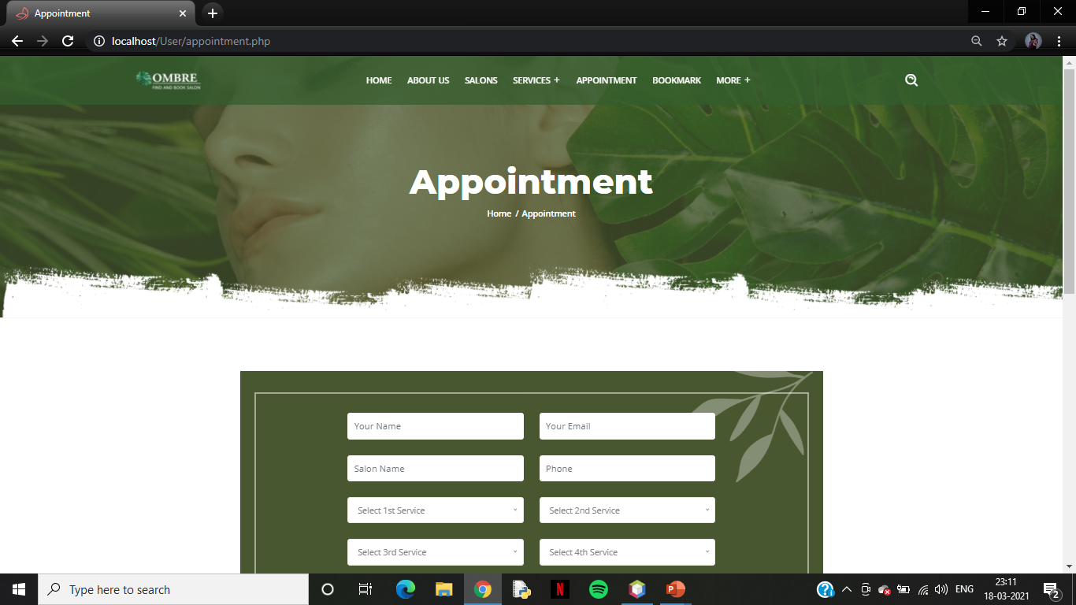
Appointment Page

Slide 33
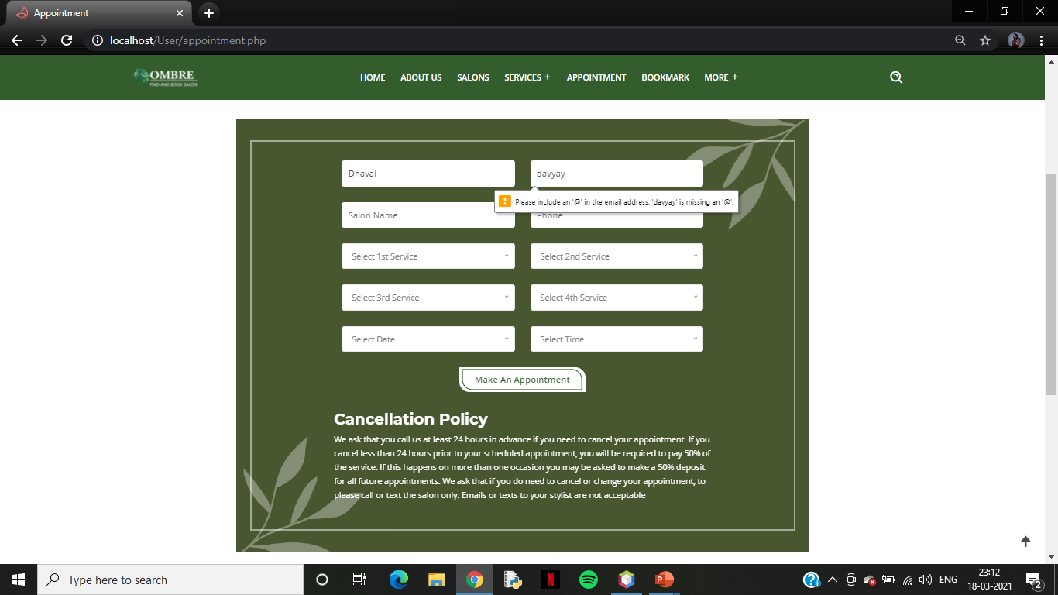
Appointment Page which shows Validations

Slide 34
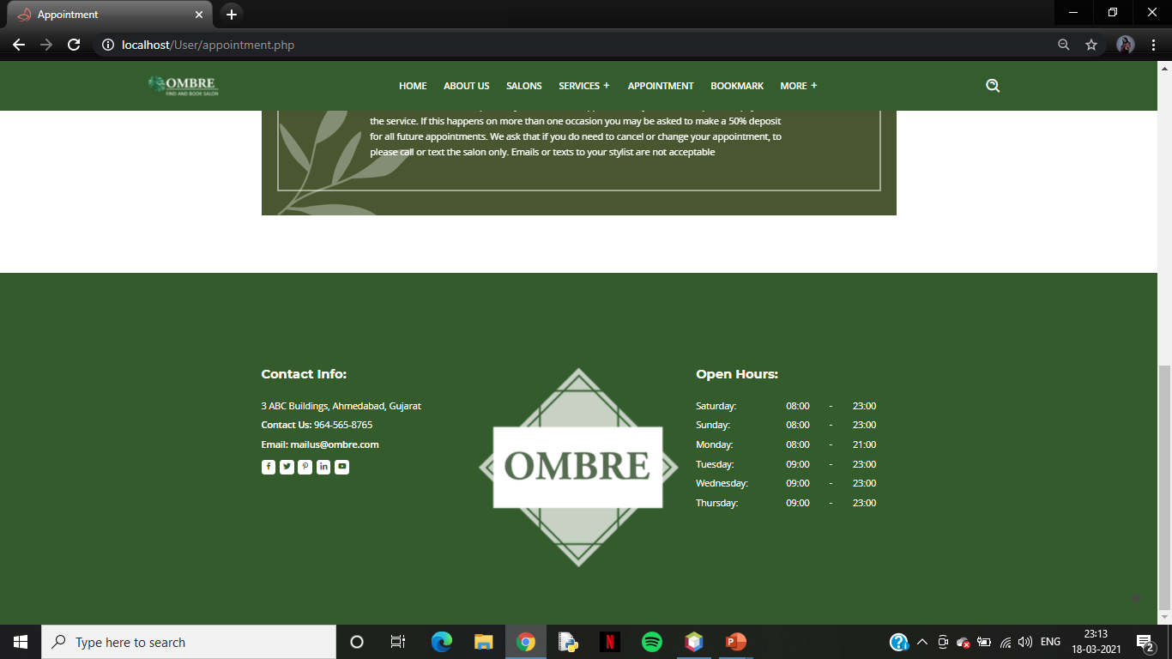
Appointment Page continue..

Slide 35
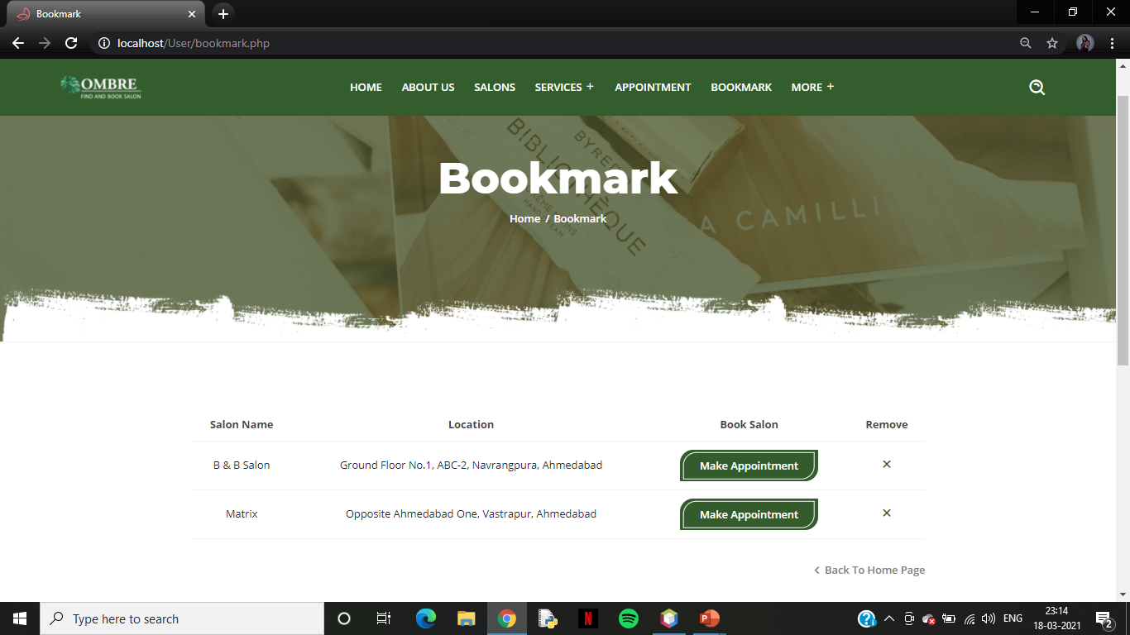
Bookmark Page

Slide 36
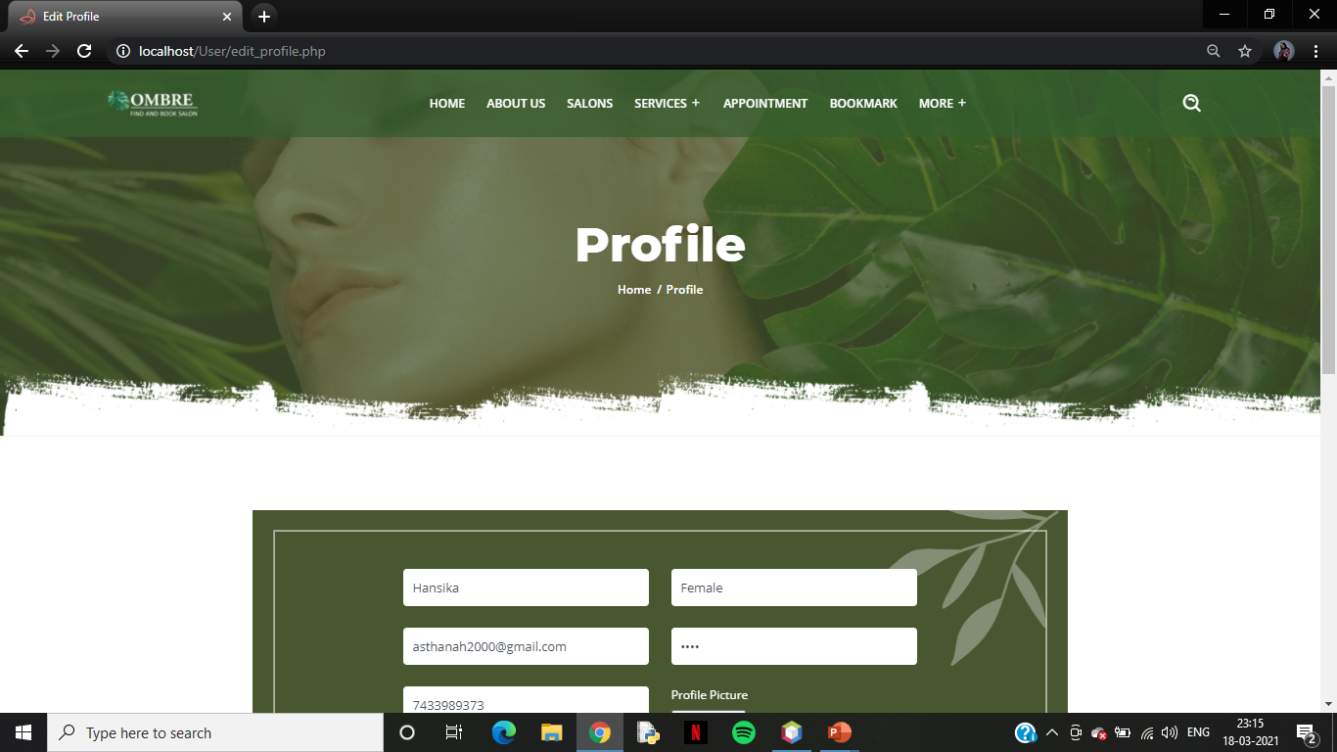
User Profile Page

Slide 37
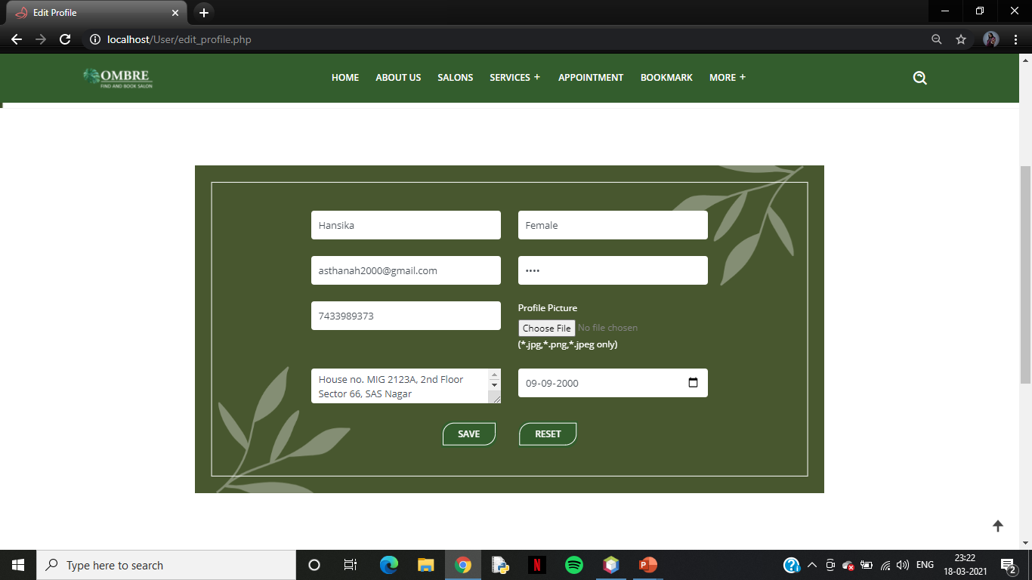
User Profile Page with Valid Data

Slide 38
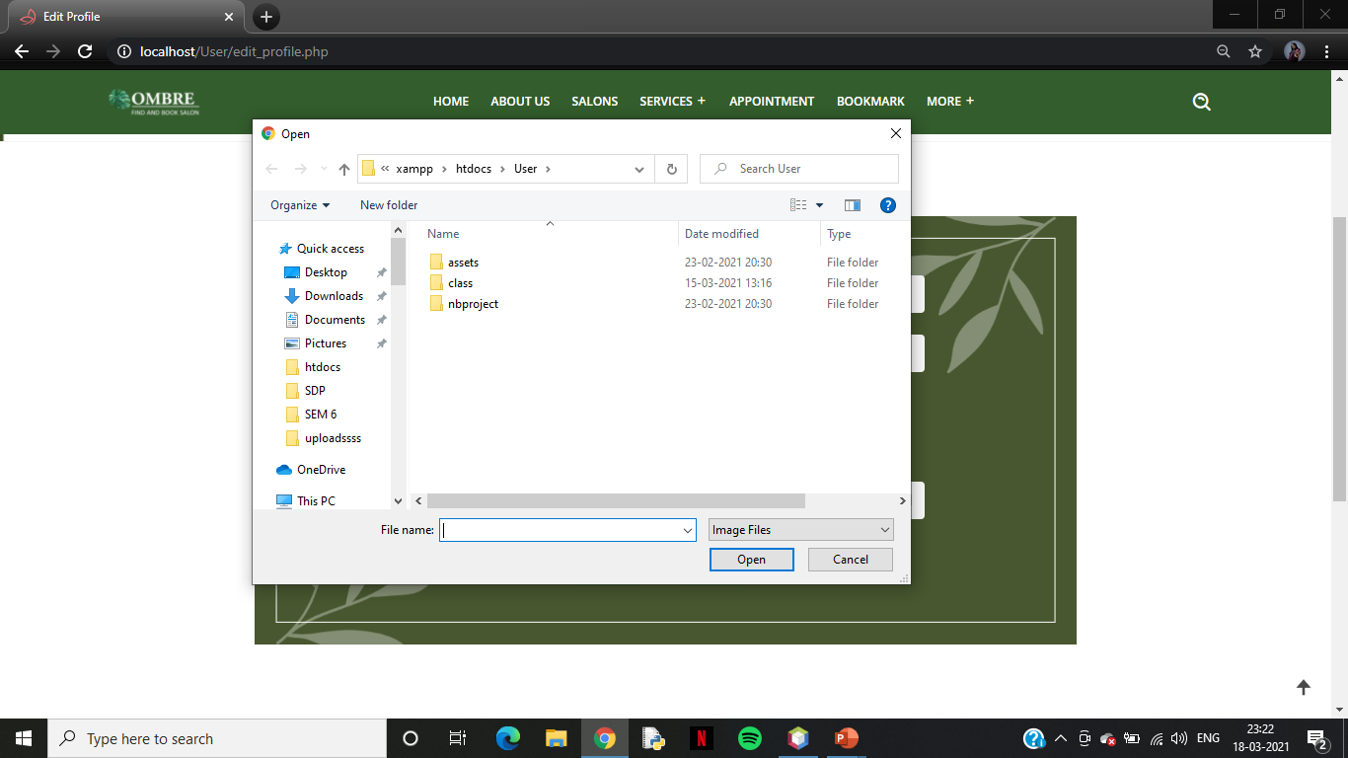
User Profile Page which shows Image Files Validation

Slide 39
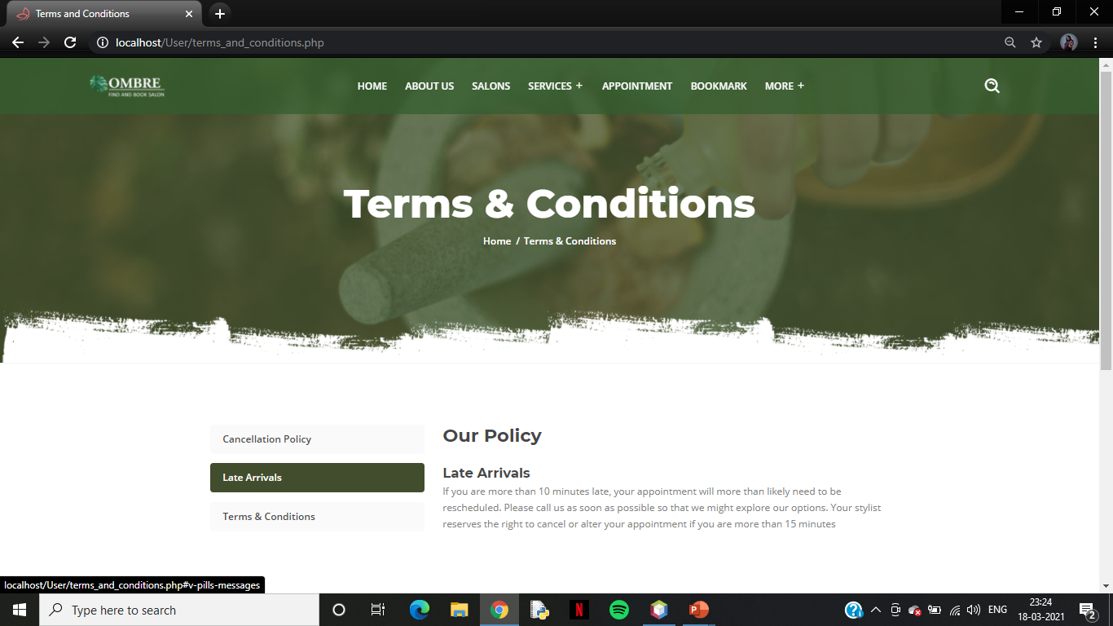
Terms and Conditions Page

Slide 40
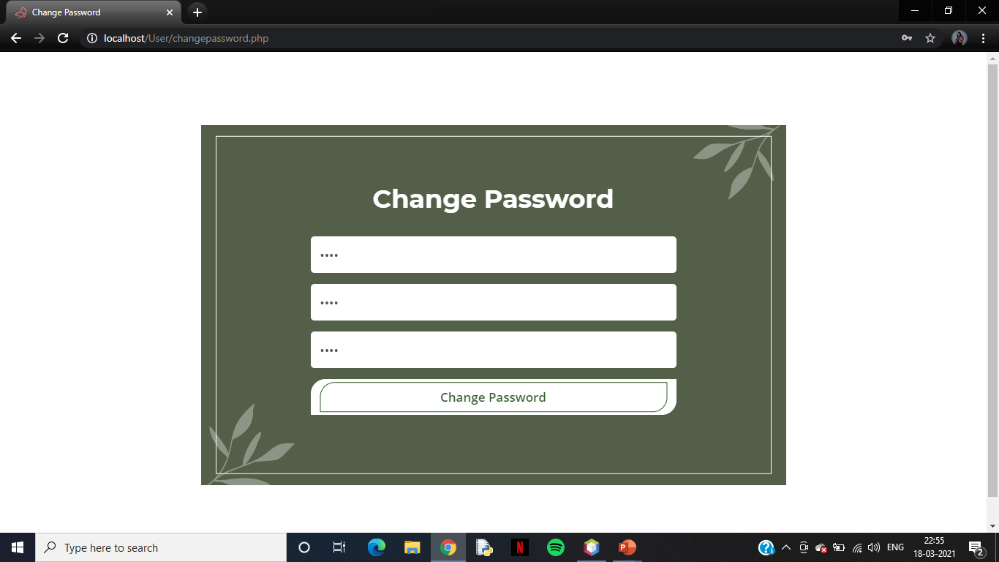
Change Password with Invalid Data

Slide 41
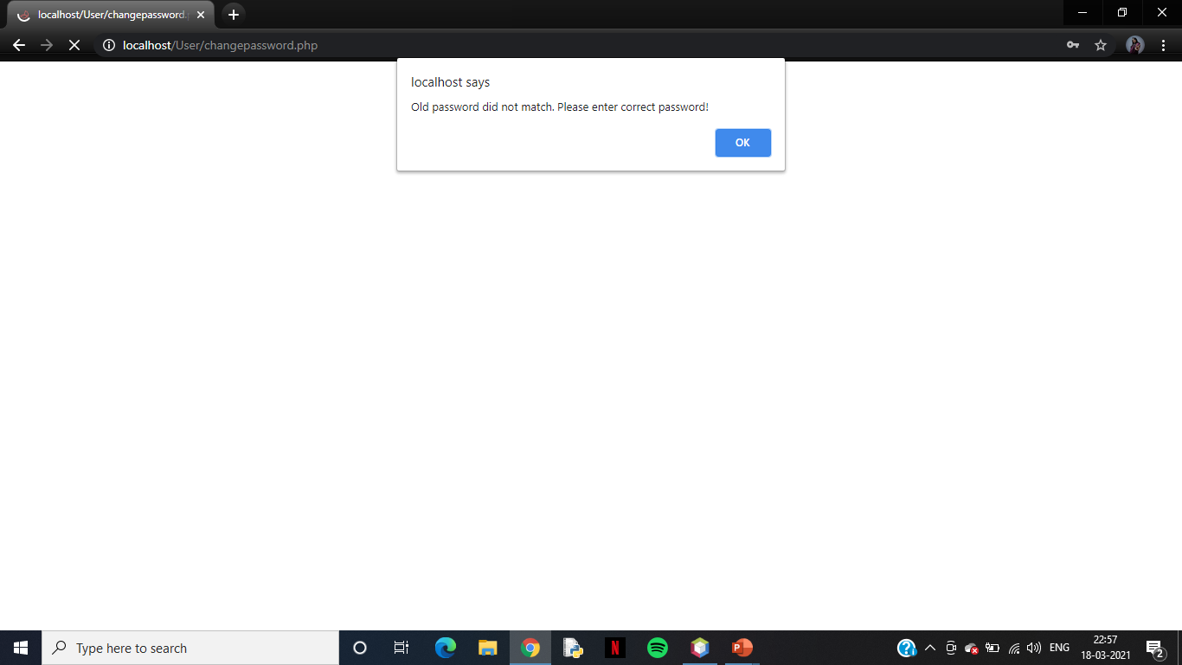
Change Password: Old Password does not match

Slide 42
Change Password continue…

Slide 43

Change Password: Wrong Input

Slide 44
Change Password continue…

Slide 45

Change Password: Wrong Input

Slide 46
Change Password with Valid Data

Slide 47

Password Change Successfully!!

Slide 48
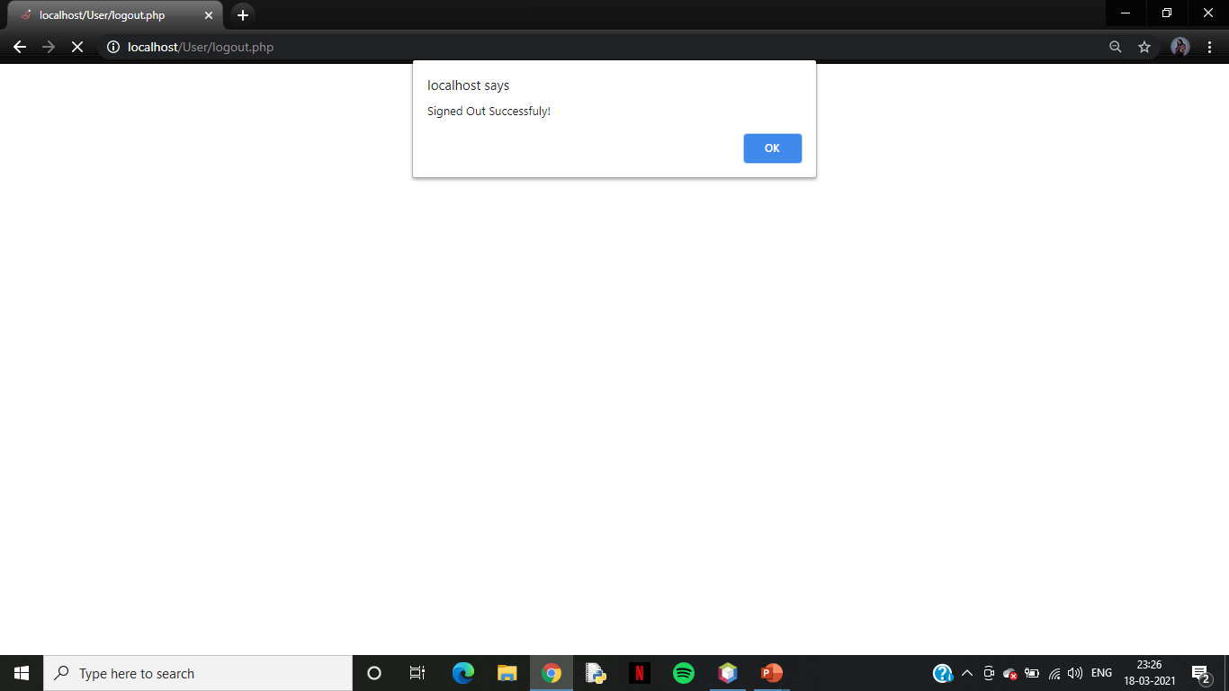
Signed Out Successfully!!

Slide 49
USER SIDE
SALON OWNER SIDE
SCREEN LAYOUTS
ADMIN SIDE
SALON OWNER
REPORTS

Slide 50
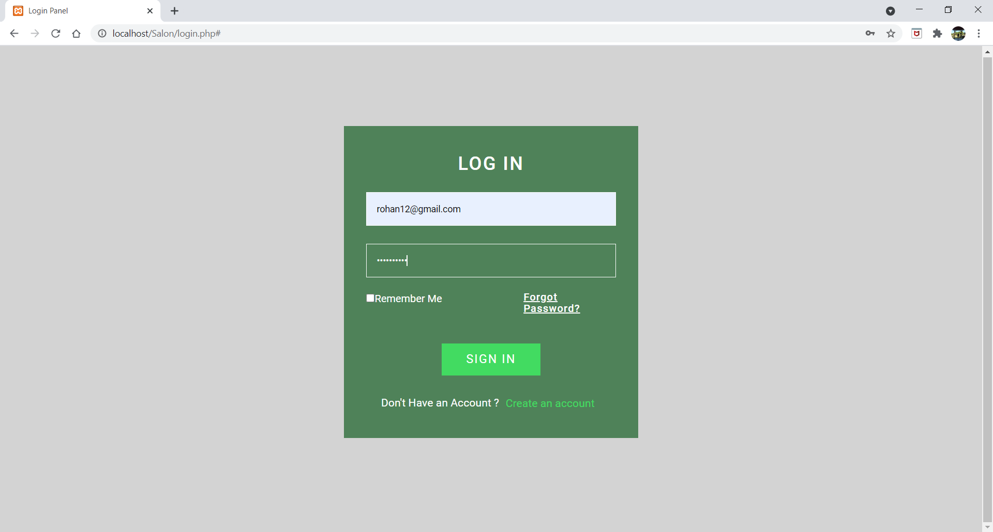
Sign In Page with Invalid Data

Slide 51
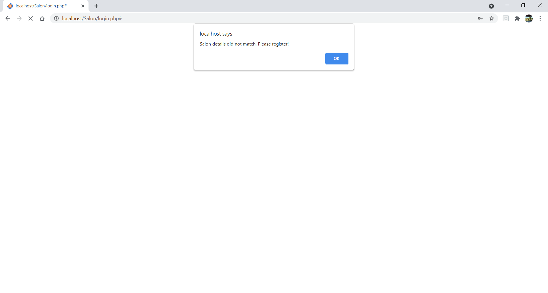
Sign In details does not match

Slide 52
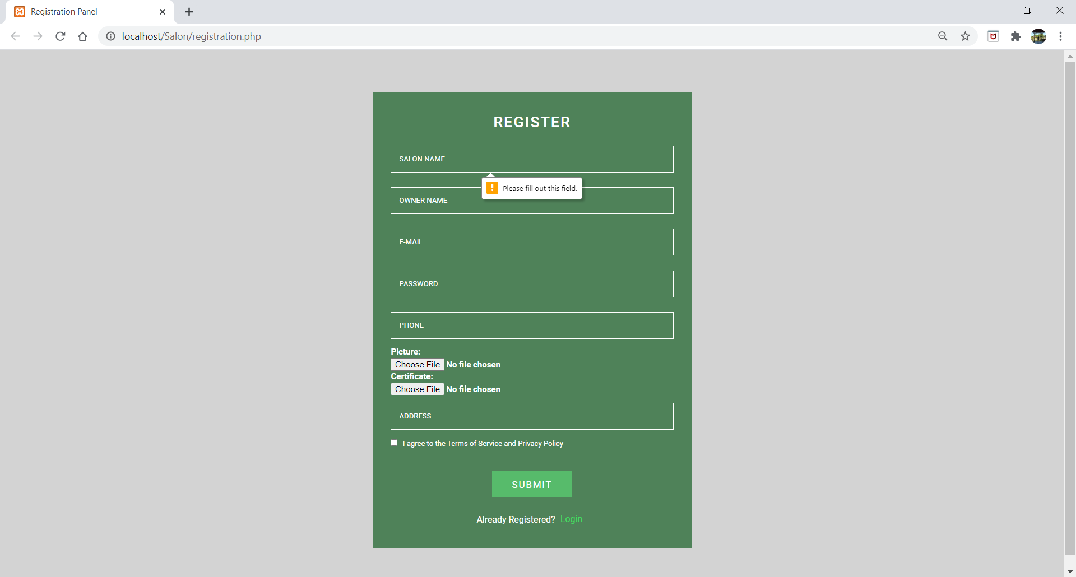
Registration Page which shows Validations

Slide 53
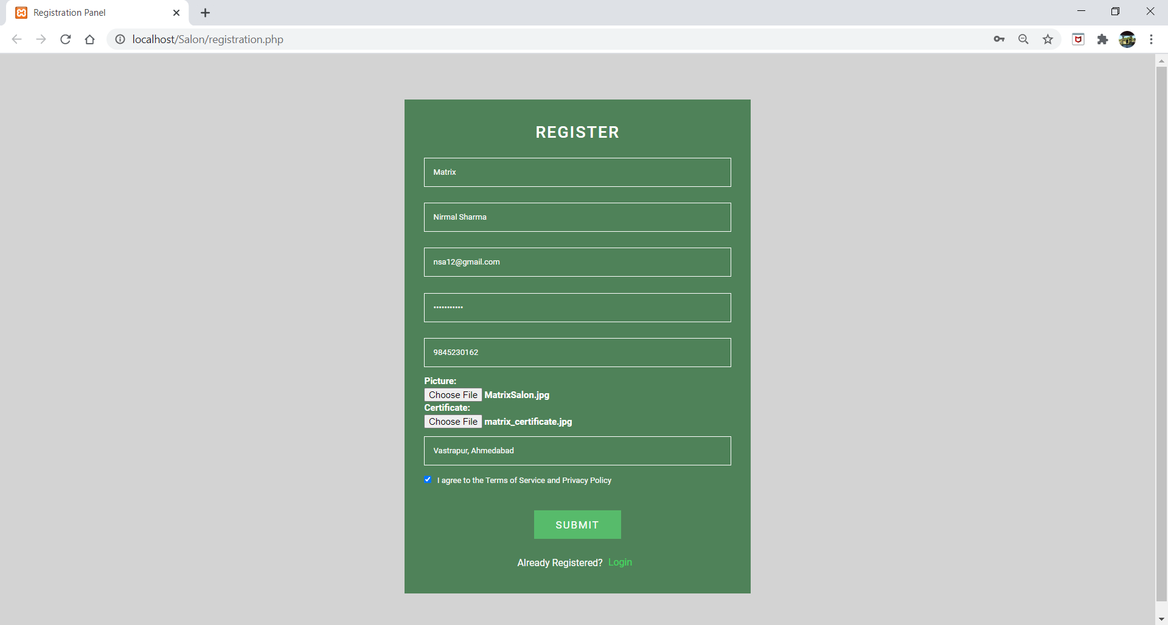
Registration Page with Valid Data

Slide 54
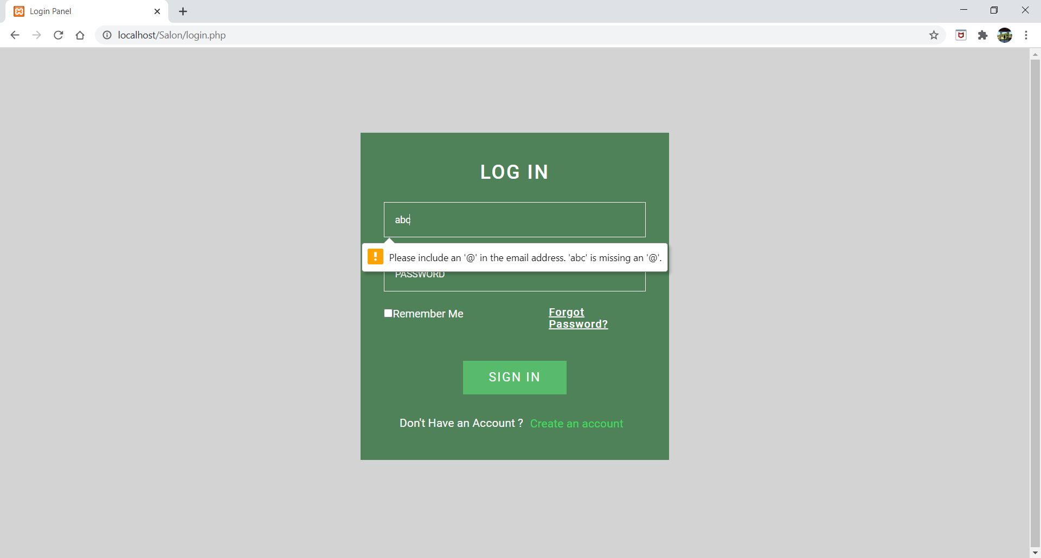
Login Page which shows Validations

Slide 55
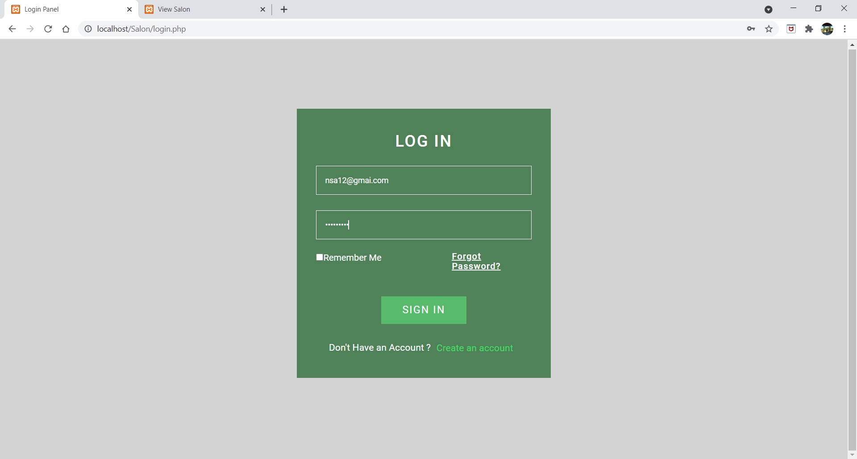
Login Page with Valid Data

Slide 56
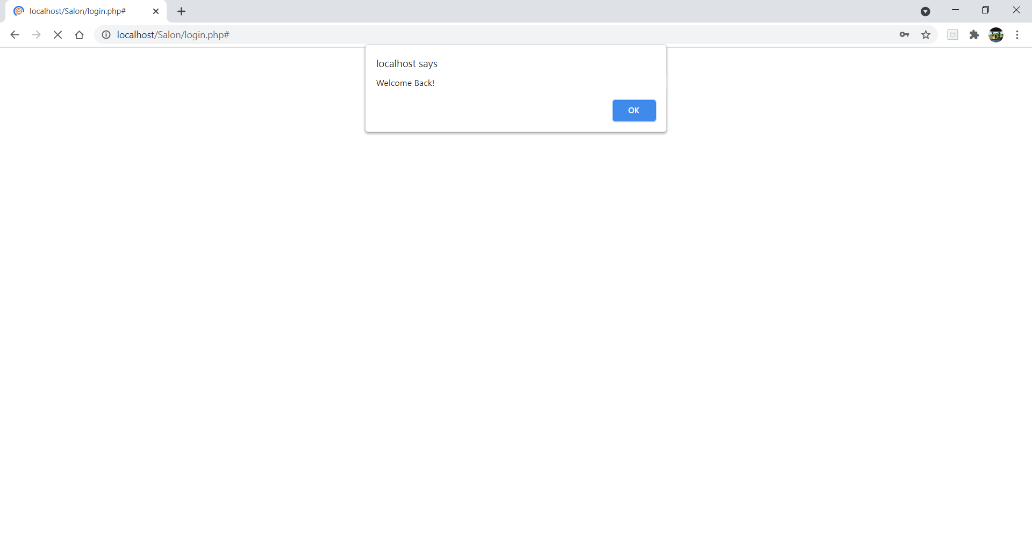
Logged In Successfully!!

Slide 57
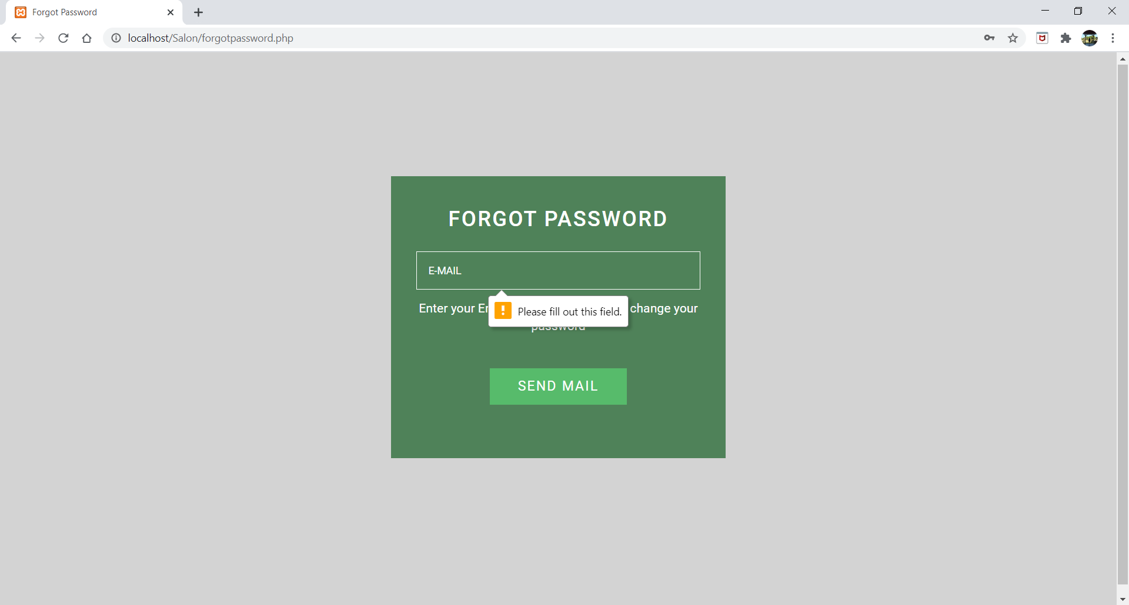
Forgot Password: Ask Salon Owner to enter Registered Email ID

Slide 58
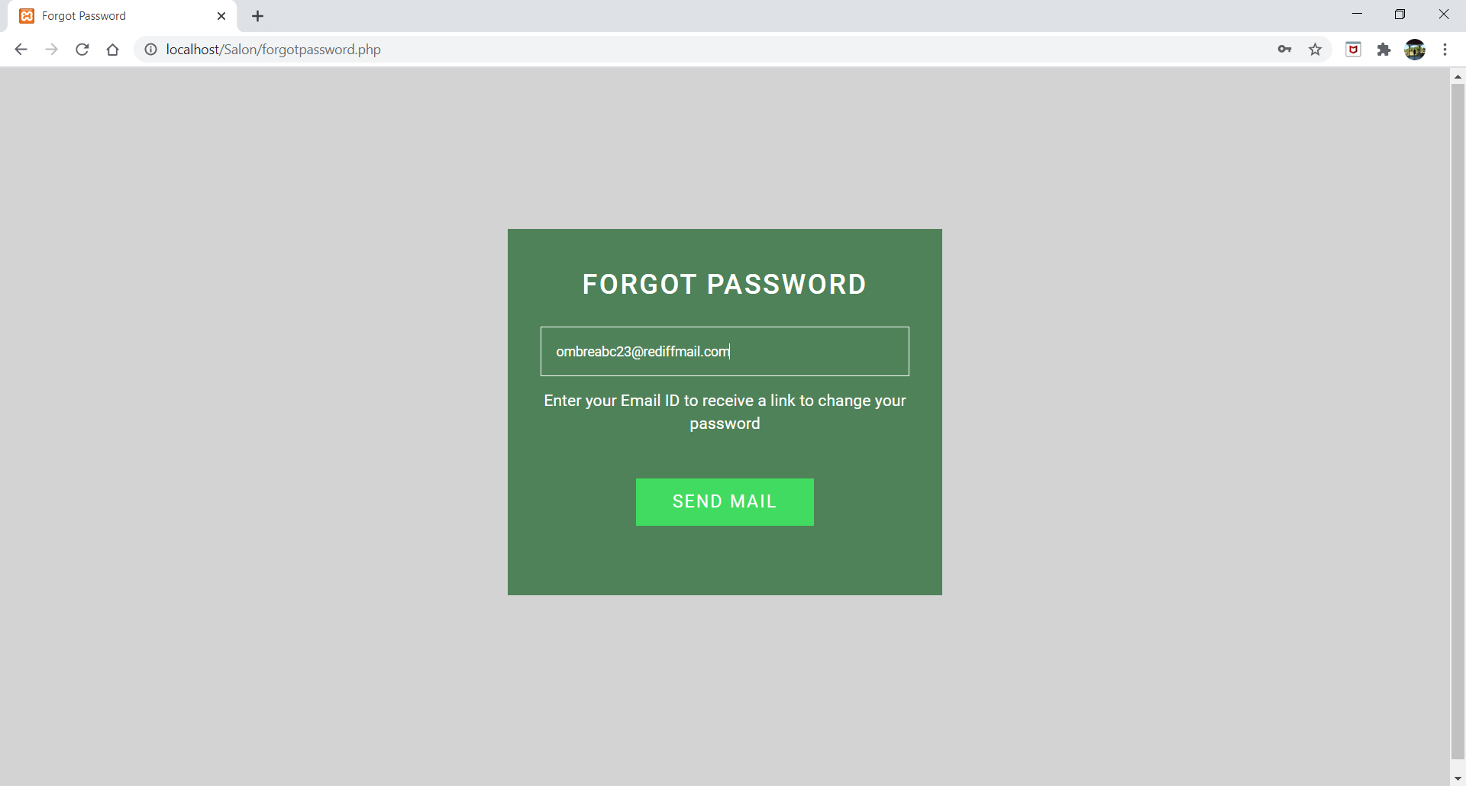
Forgot Password for Login

Slide 59
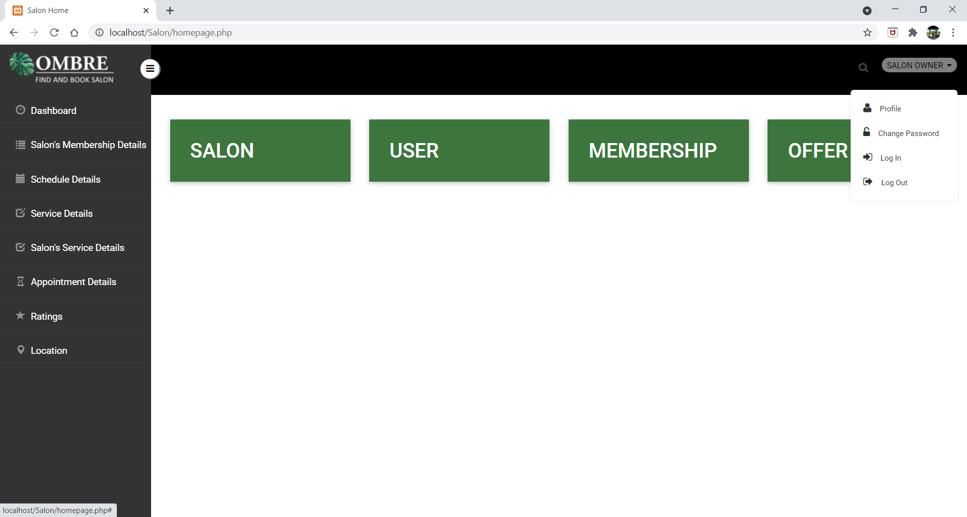
Salon Owner Dashboard

Slide 60
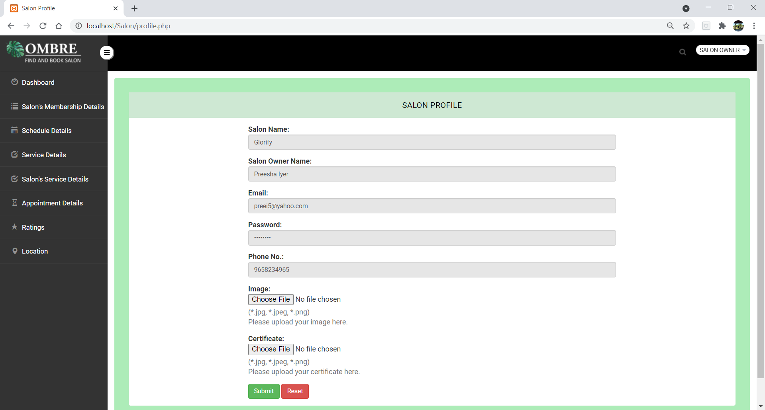
Profile

Slide 61
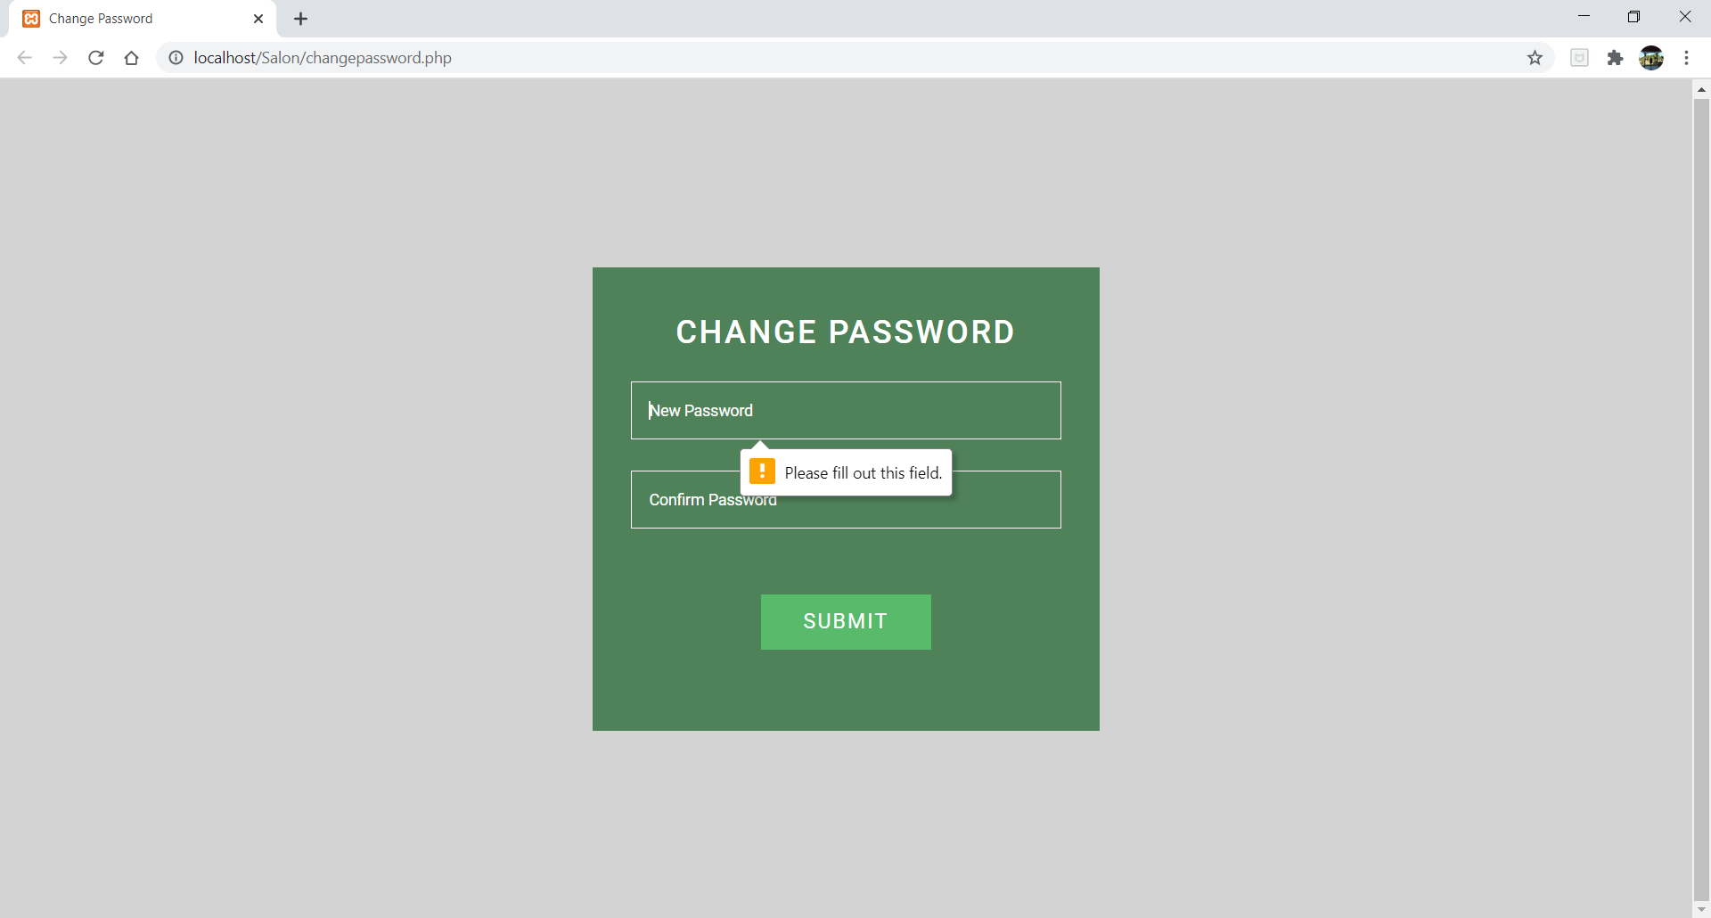
Change Password: Enter a New Password

Slide 62
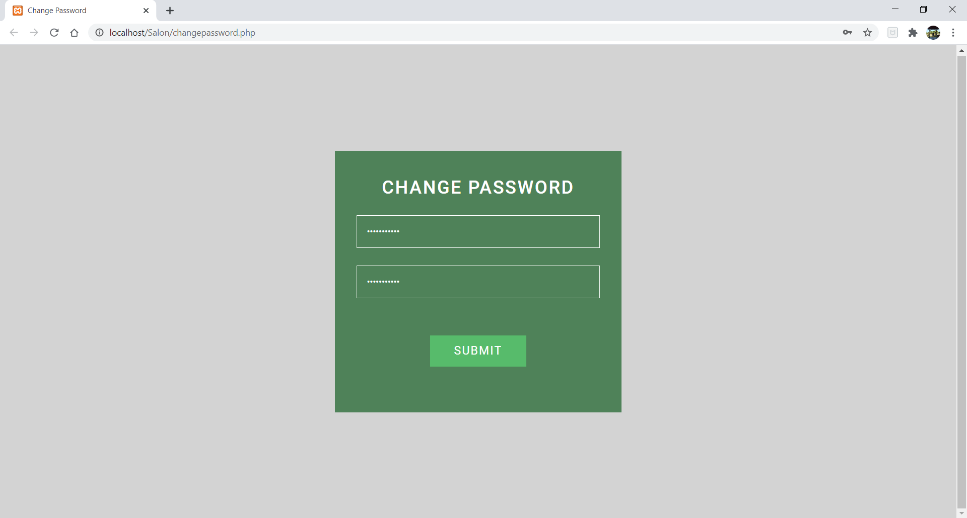
Change Password

Slide 63
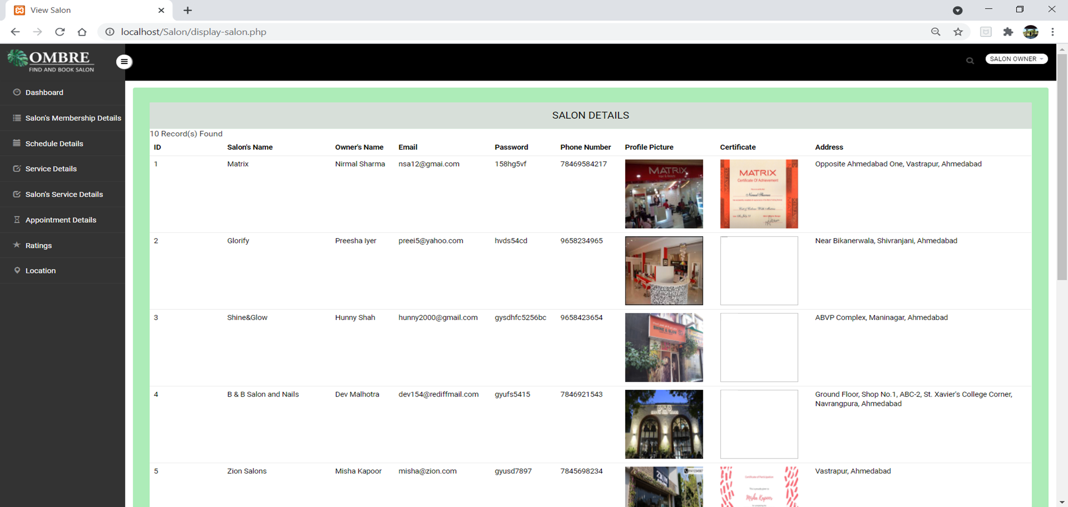
List of Salons

Slide 64

List of Salons continue..

Slide 65

User Details Page

Slide 66

User Details Page continue…

Slide 67

Details of Membership Plans for Salon

Slide 68

List of Offers

Slide 69

List of Salon’s Membership Details

Slide 70

Schedule Details Page

Slide 71

List of Services

Slide 72

List of Services continue…

Slide 73

List of Salons Services

Slide 74

Appointment Details Page

Slide 75

Rating Details provided by User

Slide 76

Location Details Page

Slide 77

Signed Out Successfully!!

Slide 78
USER SIDE
SALON OWNER SIDE
SCREEN LAYOUTS
ADMIN SIDE
ADMIN
REPORTS

Slide 79

Registration Page which shows Validations
Group 1 | Find and Book Salon

Slide 80

Registration Page with Valid Data

Slide 81

Login Page with Invalid Data

Slide 82

Login details does not match

Slide 83

Login Page with Valid Data

Slide 84

Login Page with Valid Data

Slide 85

Forgot Password: Ask Admin to enter Registered Email ID

Slide 86

Forgot Password of Login

Slide 87

Change Password: Enter New Password

Slide 88

Enter New Password

Slide 89

Admin Panel Dashboard

Slide 90

Admin Profile

Slide 91

Admin: Add Salon & Display Salon Details

Slide 92

Add Salon Page

Slide 93

Salon Details Page

Slide 94

Salon Details Page continue…

Slide 95

Add User Page

Slide 96

User Details Page

Slide 97

User Details Page continue…

Slide 98

Add Membership Plans For Salon

Slide 99

Details of Membership Plans For Salon

Slide 100

Edit Membership Plan

Slide 101

Add Offers Page

Slide 102

List Of Offers

Slide 103

Add Salon’s Membership Details

Slide 104

Salon’s Membership Details: Record Inserted Successfully

Slide 105

Details of Salon’s Membership: After adding a record

Slide 106

Add Schedule Page

Slide 107

Schedule Details Page

Slide 108

Add Services Page

Slide 109

List Of Services

Slide 110

List Of Services continue…

Slide 111

Add Salon’s Services Page

Slide 112

List Of Salon’s Services

Slide 113

Add Appointment Details

Slide 114

List of Appointment

Slide 115

Appointment Details: Record Deleted Successfully

Slide 116

Appointment Details: After deleting a record

Slide 117

Rating Details provided by User

Slide 118

List of Bookmarked Salons by User

Slide 119

Add Location Page

Slide 120

Location Details Page

Slide 121

Edit Location Page

Slide 122

Signed Out Successfully!!

Slide 123
USER SIDE
SALON OWNER SIDE
SCREEN LAYOUTS
ADMIN SIDE
REPORTS
REPORTS

Slide 124

Reports

Slide 125

Salon Details Report

Slide 126

Salon Details Report for Salon Name & Service Name

Slide 127

Location Report

Slide 128

Location Report for particular Area

Slide 129

Appointment Report

Slide 130

Appointment Report for Salon Name & Salon Services

Slide 131

Salon Membership Report

Slide 132

Salon Membership Report for Membership Plan

Slide 133

User Ratings Report

Slide 134

User Ratings Reports for User Name

Slide 135

User Bookmark Report

Slide 136

User Bookmark Report for User Name

Slide 137

Excel Sheet Example: User Bookmark Report

Slide 138
Excel Sheet Example: User Bookmark Report

Slide 139
BIBLIOGRAPHY
Reference Books:
Magnifying Object-Oriented Analysis And Design
Publisher: PHI
Author: Arpita Gopal and Netra Netra Patil
Software Project Management
Publisher: TATA McGraw-Hill
Author: Bob Hughes, Mike Cottrell and Rajib Mall
Internet:
www.w3schools.com
www.stackoverflow.com

Slide 140
CONCLUSION
Working on the project was good experience. We understand the importance of the planning and designing as a part of software development. Developing the project has helped us gain experience on real-time development procedures.
Through the development of the website, we have achieved our aim by creating this platform where Salon Owners and Users can interact easily and can manage their work in a systematic manner.
Our project makes it easy for the Users to book an appointment according to their needs and can also reschedule or cancel it. Users can bookmark a particular salon for future reference. Moreover, this system guides users by providing location wise list of salons.
We also hope to expand the scale of the project and make it ubiquitous by developing it for all digital platforms.

Slide 141
THANK YOU!
GROUP NO: 1
Internal Guide:
Miss. Nithya Nadar
External Guide:
Mr. Ronald Macwan
18BCA100 Hunny Shah
18BCA126 Vidhi Shah
18BCA151 Hansika Asthana

